Slide 1

WELCOME MEETING
Lilliput C of E Infant School
Loving one another, respecting one another, serving one another.
Year 1

Slide 2
AGENDA FOR THE SESSION
Meet the team
Curriculum
Timetables
Trips and performances
Assessment and Marking
Maths
English
Vision and Values
Growth Mindset
Homework
Behaviour
Rewards
Attendance
Contact
Questions

Slide 3
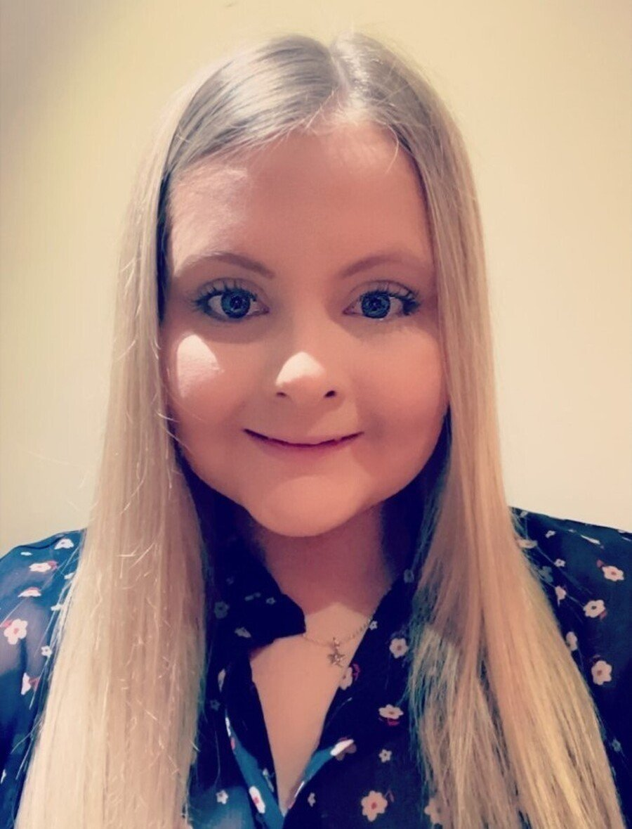
MEET THE TEAM
Butterflies
Miss Perry

Slide 4
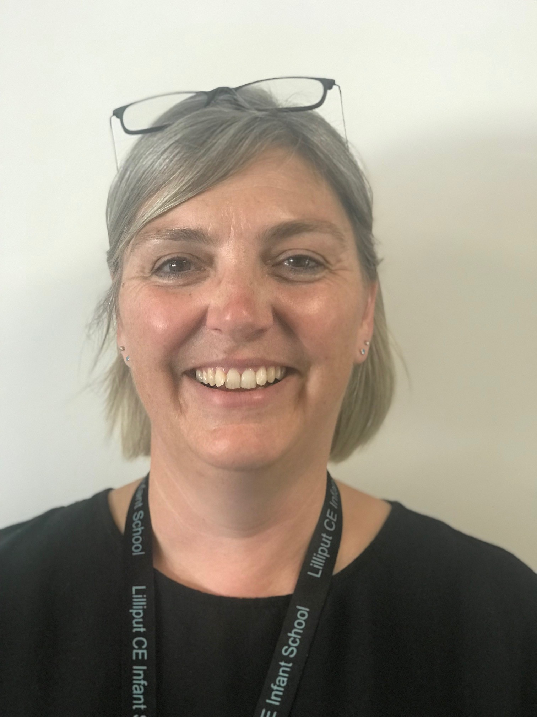
MEET THE TEAM
Fireflies
Miss White

Slide 5
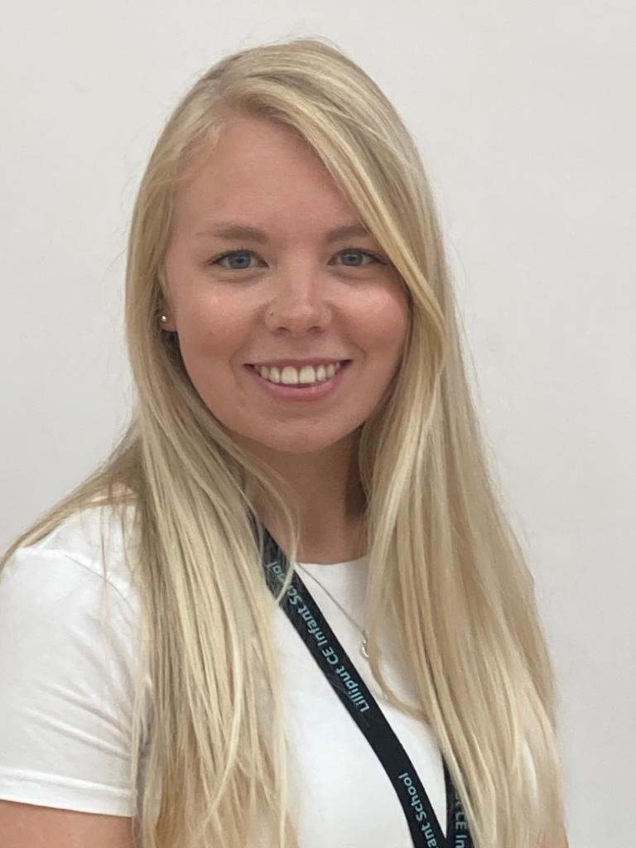
MEET THE TEAM
Dragonflies
Mrs Phipps-Bruce

Slide 6
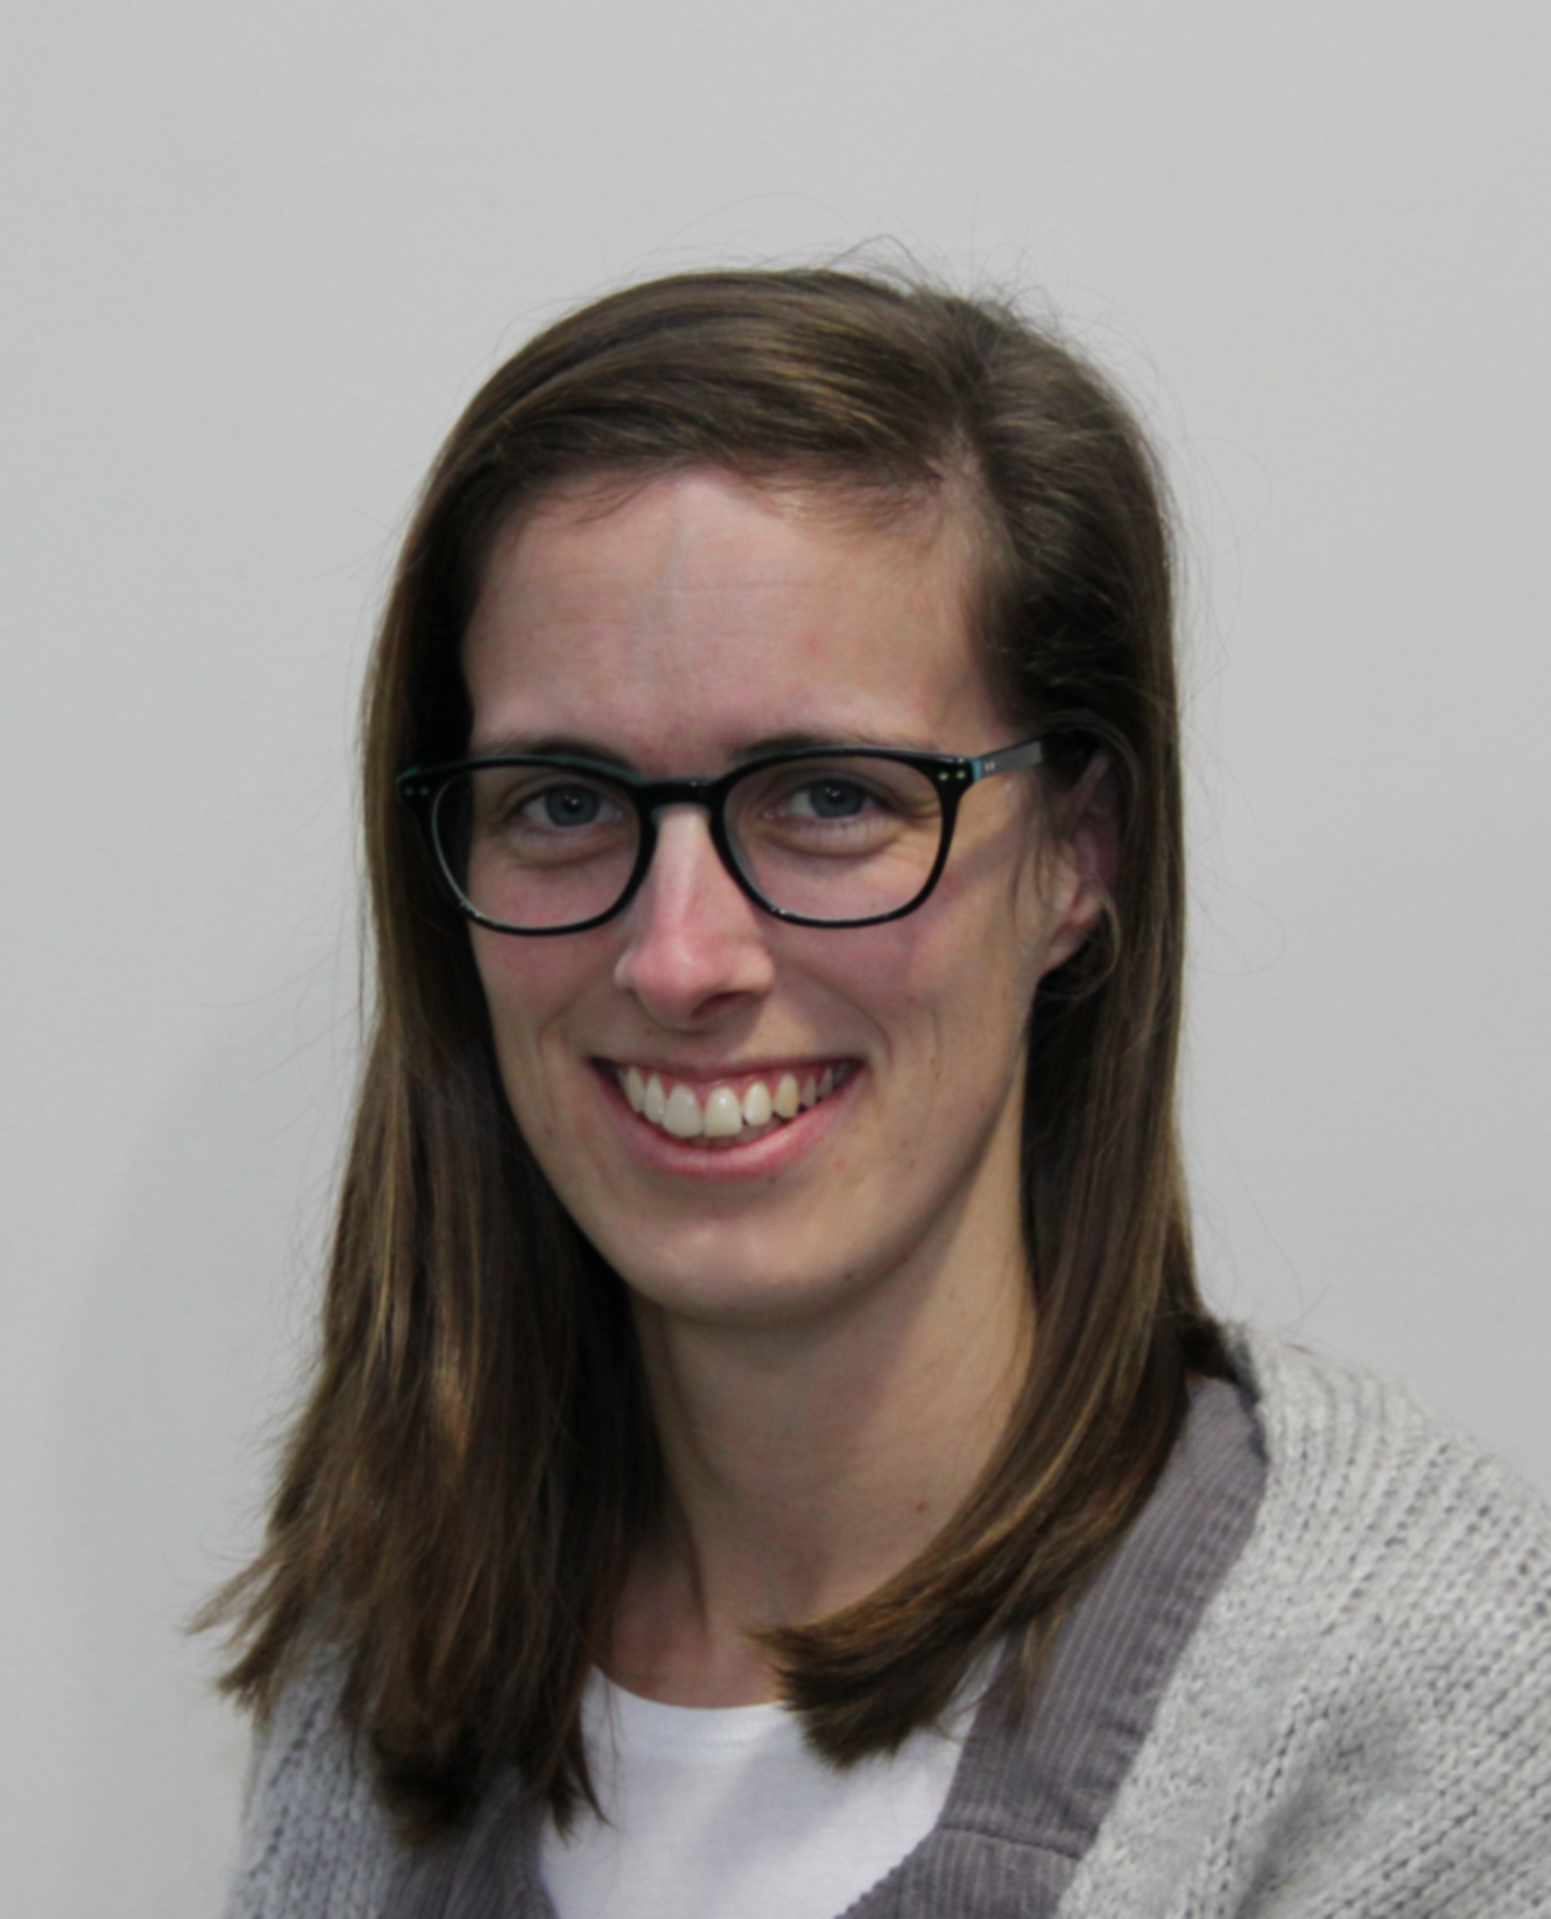
MEET THE TEAM
Grasshoppers
Mrs El Yauti

Slide 7
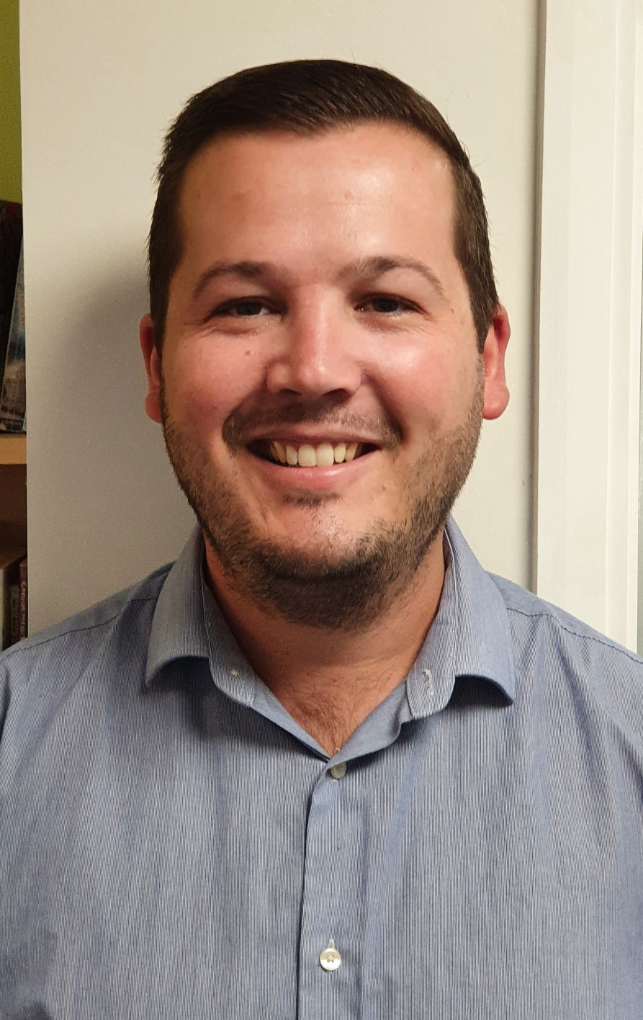
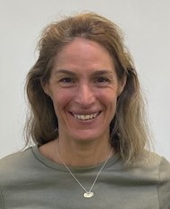
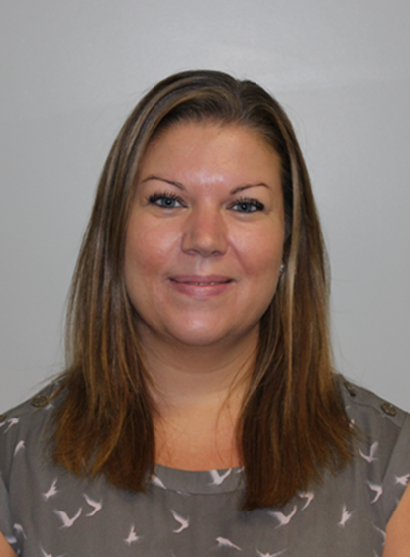
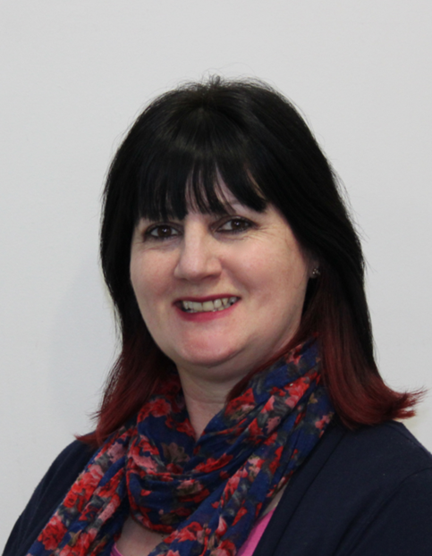
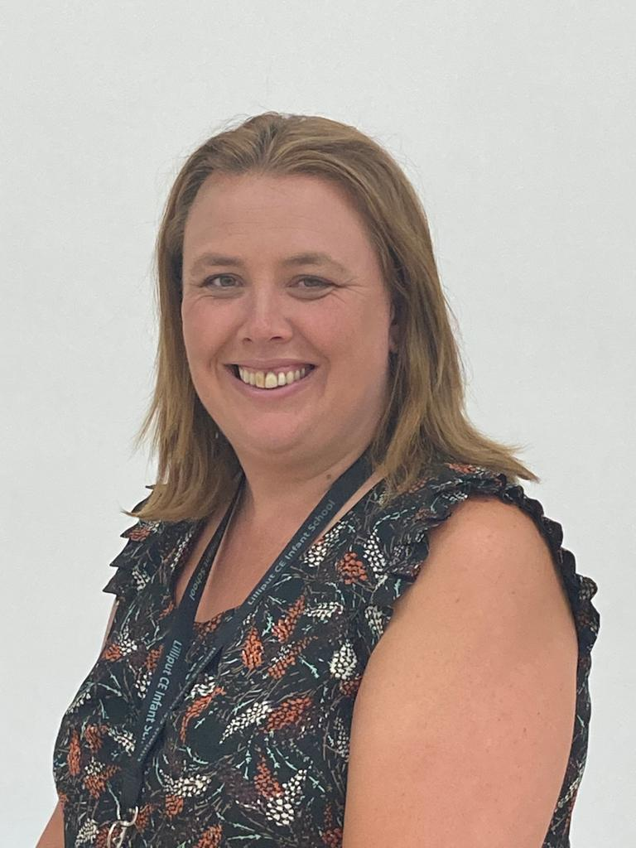
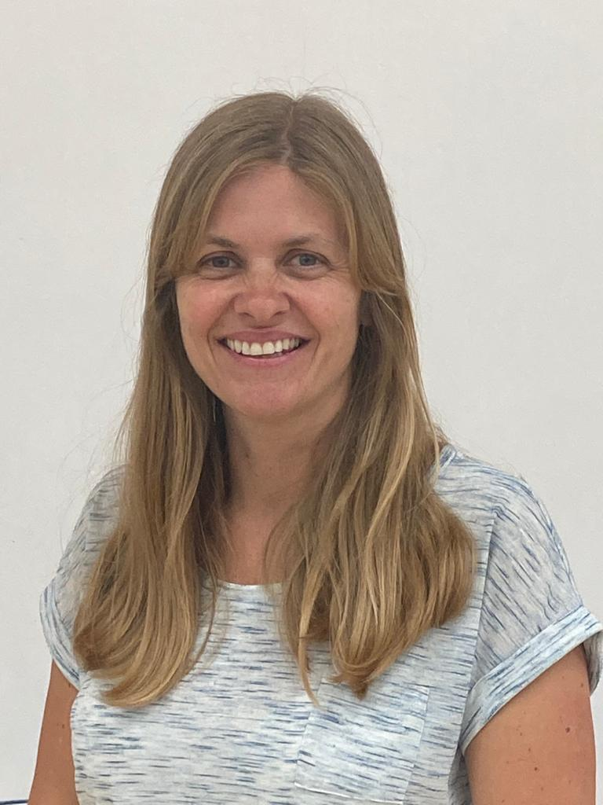
MEET THE TEAM
Teaching Assistants
Mr Maidment, Mrs Moxham, Ms Frampton, Mrs Standhaft Mrs Gregory and Mrs Milne

Slide 8
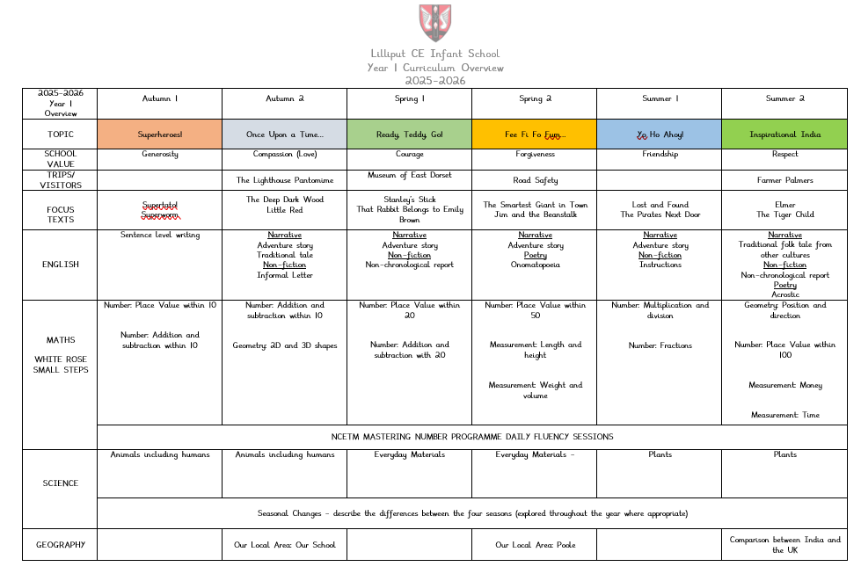
CURRICULUM OVERVIEW
A copy of our year plan can be found on our website.
Superheroes
Once Upon a Time
Ready, Teddy, Go!
Fee Fi Fo Fum
Yo Ho Ahoy!
Inspirational India

Slide 9
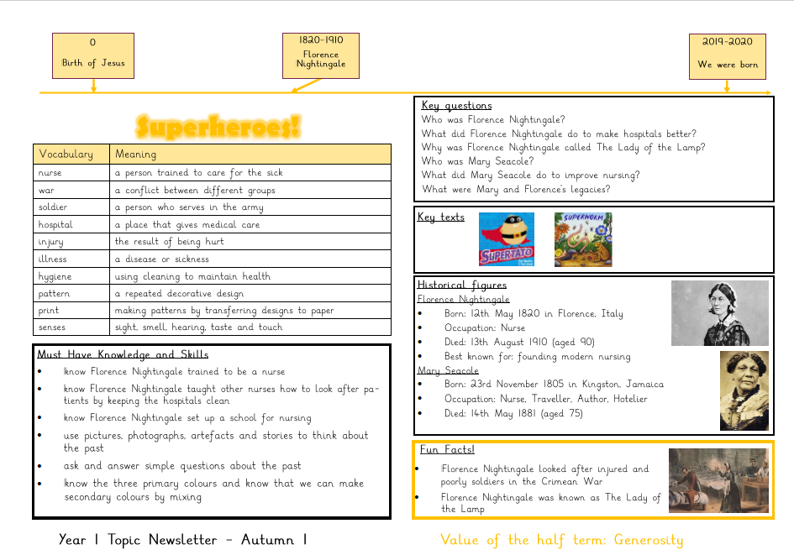
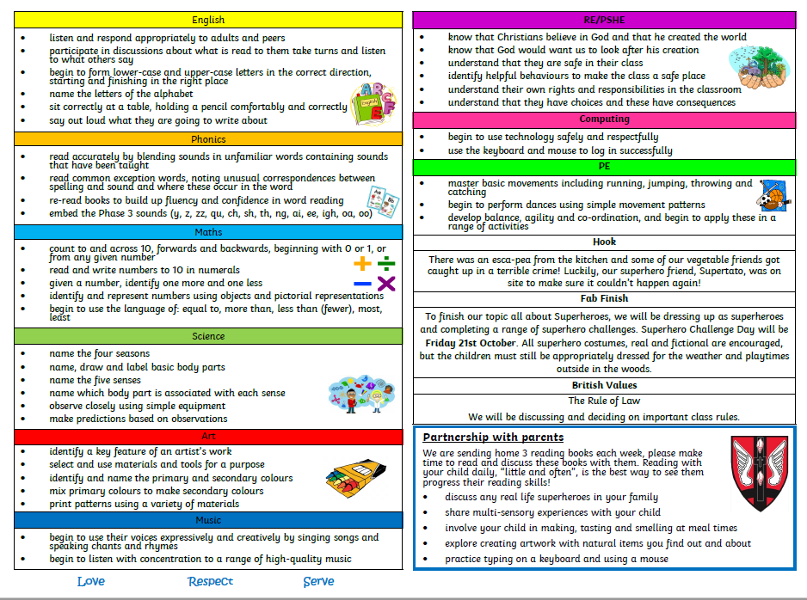
More detailed topic newsletters will also be available every half term on our website.

Slide 10
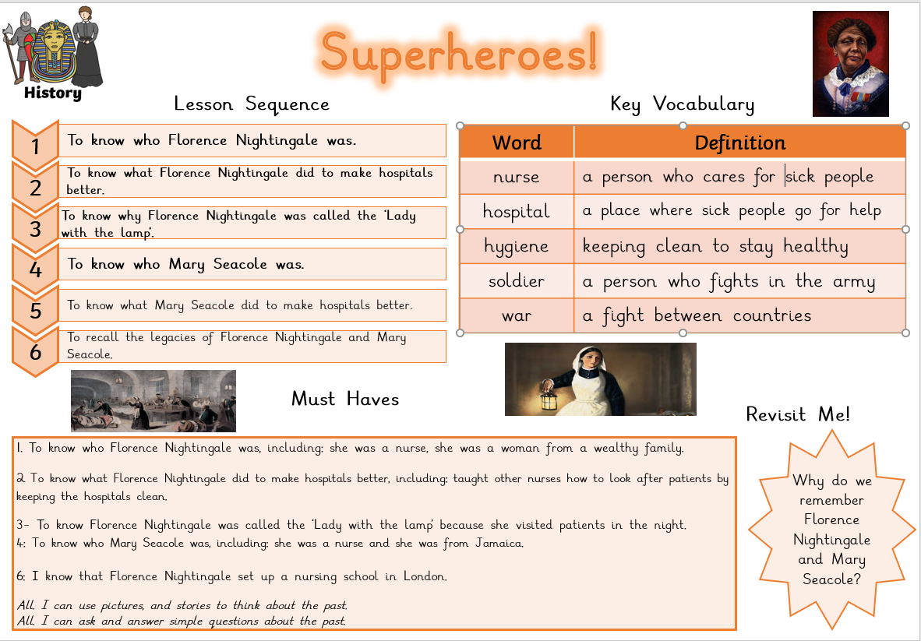
The children have book plates in their booklets so that they know the sequence of learning, the key vocabulary and ‘must have’ knowledge they will need to learn.

Slide 11
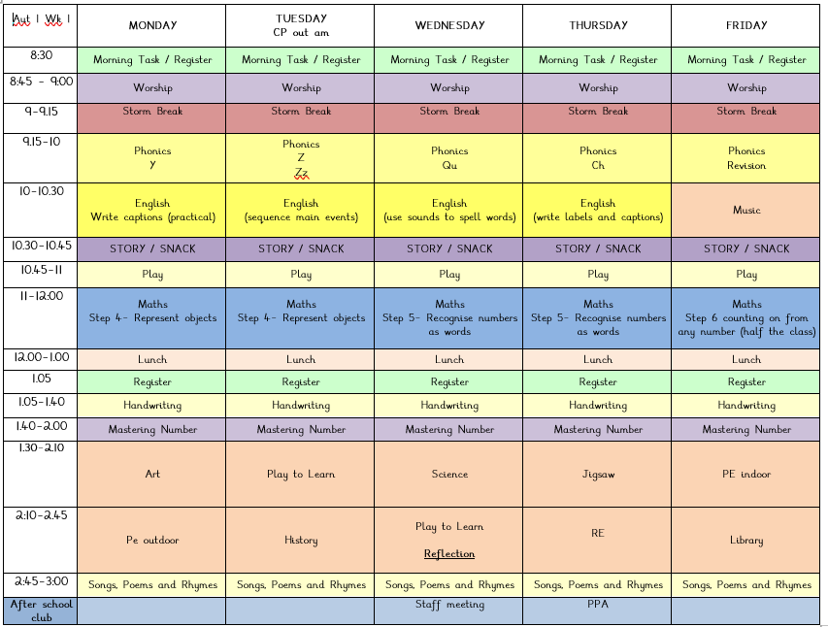
A typical weekly timetable
PE days for Year 1 are Monday and Friday.
.
Core subjects - morning
PPA – Thursday PM
Daily Worship and Stars
Class worship

Slide 12
Trips
Dick Whittington at The Lighthouse Poole (approx. £25)
All Classes – Tuesday 16th December
Museum of East Dorset (Approx. £15)
Butterflies – Tuesday 3rd February
Grasshoppers – Thursday 5th February
Dragonflies – Tuesday 10th February
Fireflies – Wednesday 11th February
Farmer Palmers (Approx. £18)
Butterflies and Grasshoppers Tuesday 30th June
Dragonflies and Fireflies Wednesday 1st July
Notes:
KC

Slide 13
Performances
Class assemblies
Details are on the yearly diary dates but all start at 2.30pm in the school hall. The exact class dates will be out soon!
There will also be a Nativity Play performed by Year 1 in the hall to parents and a Christmas service at the Church, dates for these are on the school calendar and key dates sheet.
Notes:
KC

Slide 14
Assessment and Marking
  Highlighting – pink (for positives), green (areas of improvement) and blue (for challenge).
  Green highlighted spellings and number reversals will be practised three times on the lines.
  All work is presumed to be independently completed unless marked with T (Teacher assisted) or TA (Teaching Assistant assisted).
  Assessment
  Year 1 phonics screening – June
  We will discuss your child’s progress and next steps during parents evenings and in their annual report.
Notes:
CP End of KS1 – Year 1 phonics screening will now take place in Autumn 2 – we will be working closely with your child to ensure they are secure in their phonic knowledge. Some support may be be sent home. Children who don’t pass will have some extra sessions in school and parents will be kept fully informed and supported ☺
Teacher assessment supported by tests and tasks – Please don’t worry about these – they form part of our on going assessment and the children really enjoy them!
Parents evenings slide next

Slide 15
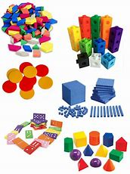
Maths in Year 1
We follow a Concrete Pictorial Abstract approach to teaching Maths and have a wide variety of manipulatives available for the children to use.
Number and Place Value (within 10 → 20 → 50 → 100)
Addition & Subtraction (within 20)
Properties of shape
Multiplication & Division
Measurement – Length & Height / Mass & Volume / Money / Time
Fractions
Position and direction
Notes:
KC What your child will learn in Y2 – please take a look at the curriculum documents on the school web site -
A Maths evening will announced shortly and recorded for you to watch at your leisure for all year groups SR
We always build on Year 1 learning and we always spend time identifying any gaps in learning when the year 1s join year 2 – this year is no different – we start where the children are and build confidence and skills

Slide 16
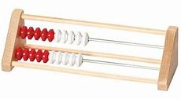

Mastering Number Programme
In addition to our Maths lessons we also develop the children’s fluency and number sense by teaching the Mastering Number Programme.
This not only enables children to be confident in recalling their number bonds, halves, doubles and subitising skills but it also exposes them to the structures and patterns that are present in Maths.
Notes:
KC What your child will learn in Y2 – please take a look at the curriculum documents on the school web site -
A Maths evening will announced shortly and recorded for you to watch at your leisure for all year groups SR
We always build on Year 1 learning and we always spend time identifying any gaps in learning when the year 1s join year 2 – this year is no different – we start where the children are and build confidence and skills

Slide 17
Writing in Year 1
Focus for Year 1
Letter formation (print)
Basic SPaG:
- Capital letters
- Full stops
- Finger spaces
- Common Exception Words
- Phonically plausible
- The conjunction ‘and’
Writing genres
Predominantly Narrative
Exposure to other genres, such as:
- Letters
- Non-chronological reports
- Recounts
Notes:
BB - Mastery approach to writing – children able to transfer writing skills from English across all subjects and genres. Learning is totally embedded.
Learn skills – spelling, punctuation and grammar
Apply in creative contexts SR

Slide 18
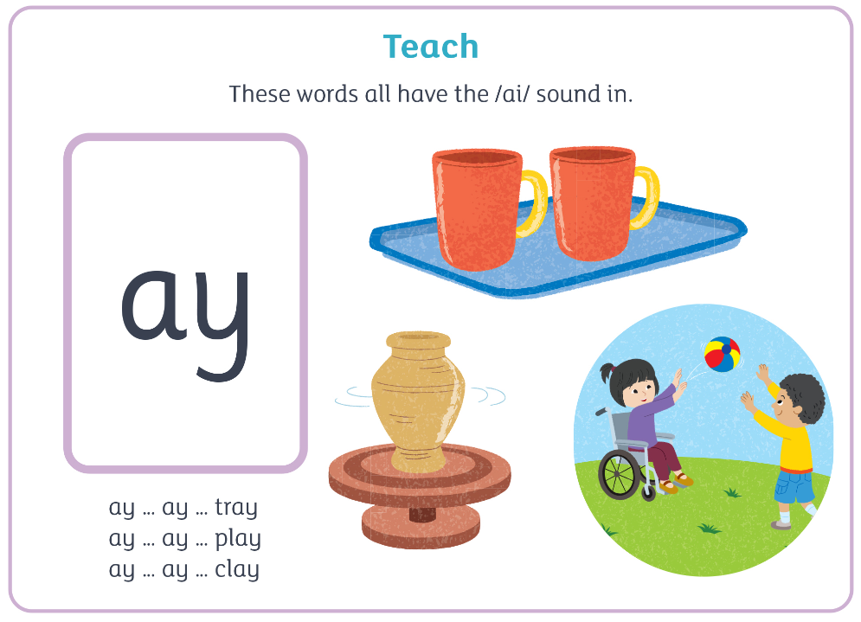

Reading in Year 1
Our main focus is teaching your children to decode via phonics (ELS).
Comprehension skills are developed during whole class stories and 1:1 reading sessions.
It is our aim to hear your child read 1:1 a minimum of twice a week.
We regularly complete assessments to identify gaps and accurately match a child’s reading book to their ability.
We visit the library weekly and issue each child with a library book.
Notes:
BB - Please read the guidance in the books before starting a reading session MS
Don’t expect children to read a book a night or all 3 books in the week!
Check any words at the bottom of the page

Slide 19
Home Reading
In Year 1 we send home 3 books at a time and these should be read 3 times.
Once a week your child’s reading will be checked and a member of staff will acknowledge the reading happening at home. Children will be rewarded with a Dojo point for 3+ reads and 2 Dojo points for 5+ reads.
By moving away from writing comments every time we read with your child we make reading more efficient and this allows us to read with more children. Your children are still being read with in school regularly – it is a core principle of our teaching of reading at Lilliput.
We encourage you to read with your children daily (approximately 10 minutes per day) to build fluency.
Mrs Chambers’ Reading Challenge
Monday - Red Group
Tuesday – Blue Group
Wednesday – Green Group
Thursday - Yellow Group
Friday - Purple Group
Notes:
BB - Please read the guidance in the books before starting a reading session MS
Don’t expect children to read a book a night or all 3 books in the week!
Check any words at the bottom of the page

Slide 20

Our school vision and values
We come together for an act of daily collective worship in the school hall led by a member of the SLT.
We also have weekly reflection time in class where we focus on the value of that half term.
On Friday we celebrate the children’s successes in our Star of the Week assembly.

Slide 21

Growth mindset
We encourage children to have a growth mindset, to be resilient and to learn from their mistakes.

Slide 22
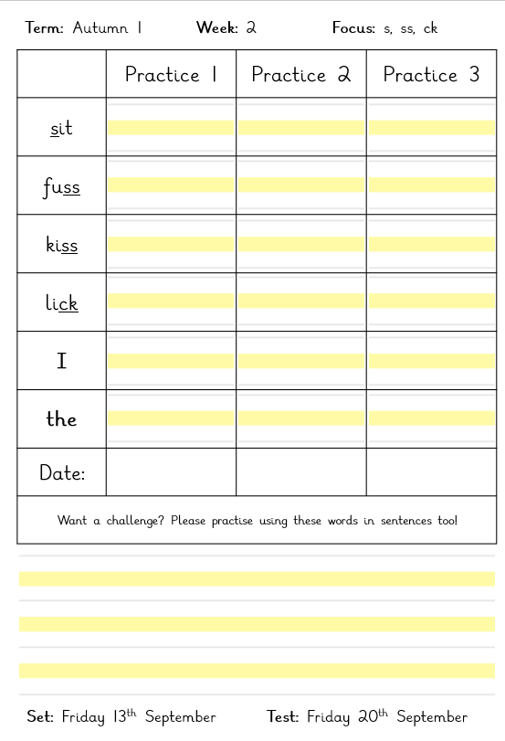
Homework
Spellings will be set weekly and children will be tested on these on a Friday. There are three spaces on their sheet for them to practise their spellings a minimum of three times throughout the week ahead of the test. Test are completed in their books at the back for you to see how they got on.
Tasks are assigned weekly on Mathletics and tie in with our curriculum, which are completed online to gain points. Children who play regularly and earn enough points receive Mathletics certificates (bronze, silver and gold).
A minimum of 3 short reads minutes weekly with comments in reading diaries that reflect this but we do encourage reading to be as often as possible. Drop it for 10.

Slide 23
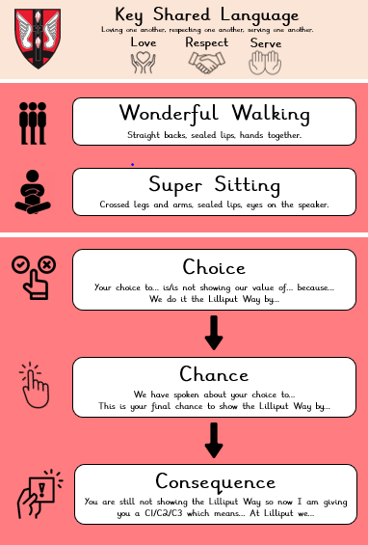


Our behaviour policy
Notes:
KC We are very proud of our positive approach to behaviour management at school. This is achieved through praise and careful reward systems.
Our behaviour policy includes the use of the child-led behaviour books to record when a child has forgotten one of the school rules that we have all agreed on. This is a tool, not a threat and the children understand that this is a way of learning about and improving behaviour so that everyone feels safe and happy at school.

Slide 24
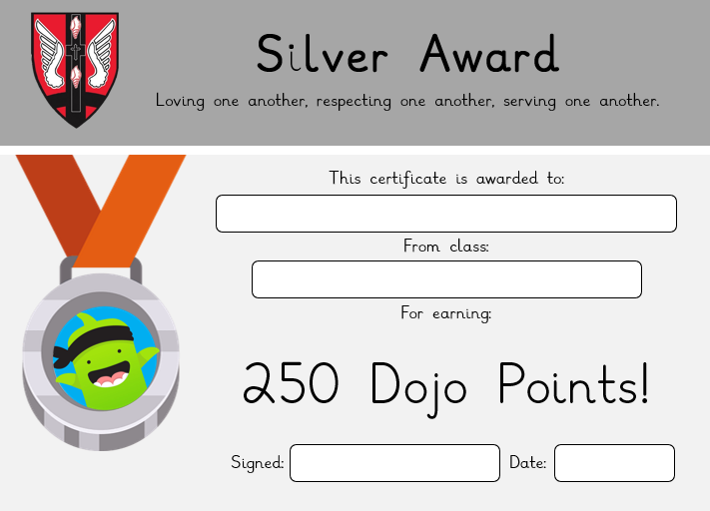
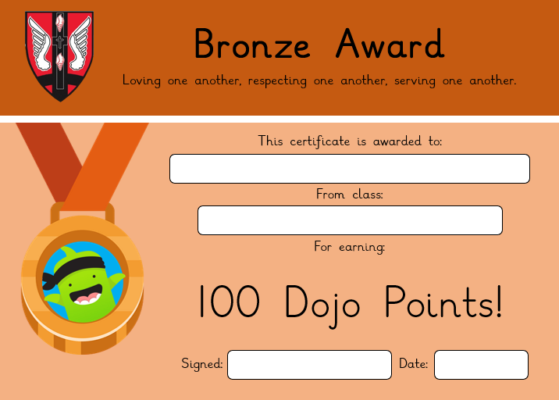

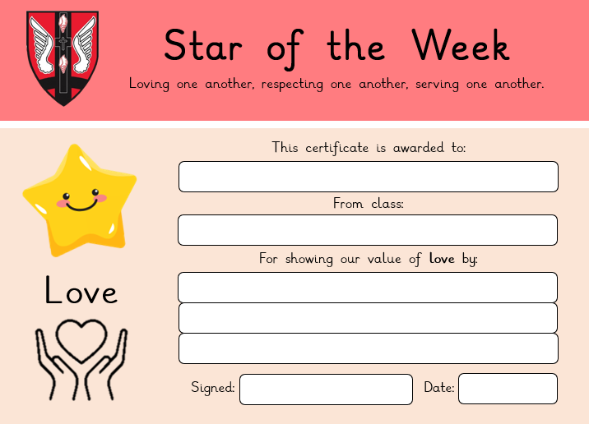
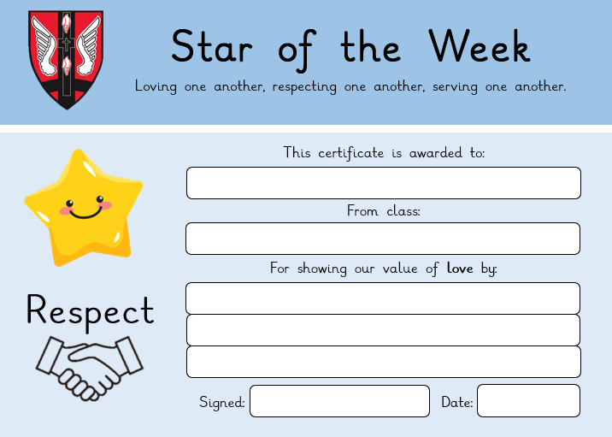
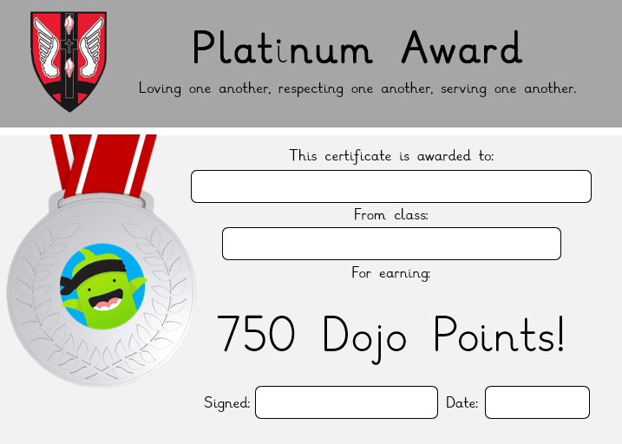
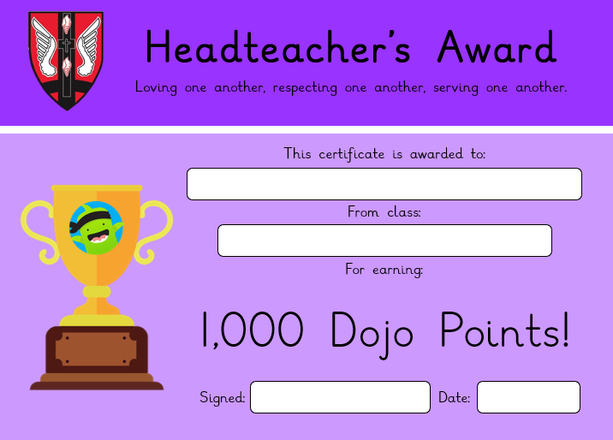
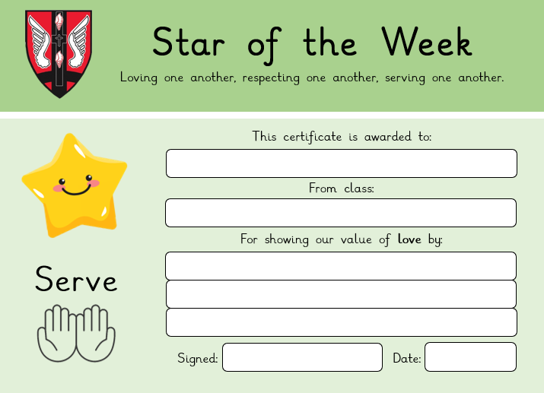
Rewards
Stars of the Week (linked to our core values of love, respect and serve)
Dojo points are given and totalled up at the end of the week. The winning class with the most amount of Dojo points receive extra playtime.
Dojo points are also tracked and milestones (100, 250, 500, 750, 1000+) are awarded to individual children.
Sports Person of the half term.
Diamond Diners
Notes:
KC We are very proud of our positive approach to behaviour management at school. This is achieved through praise and careful reward systems.
Our behaviour policy includes the use of the child-led behaviour books to record when a child has forgotten one of the school rules that we have all agreed on. This is a tool, not a threat and the children understand that this is a way of learning about and improving behaviour so that everyone feels safe and happy at school.

Slide 25
Rewards
Class Mascots – These are sent home every Friday. Please fill in the diary so your child can share their adventures with their mascot back in class. Please do not include any photos of your child in these books
Notes:
KC We are very proud of our positive approach to behaviour management at school. This is achieved through praise and careful reward systems.
Our behaviour policy includes the use of the child-led behaviour books to record when a child has forgotten one of the school rules that we have all agreed on. This is a tool, not a threat and the children understand that this is a way of learning about and improving behaviour so that everyone feels safe and happy at school.

Slide 26
Housekeeping
Book bags – please ensure you empty your child’s book bag every night. They are allowed one small keyring attached to their book bags as we don’t have the storage space for large toys to be attached.
Book bags should include the child’s home learning folder. Their reading books, reading record and spelling books should be kept in there at all times. The children are then responsible for getting these out in the morning and putting them in their colour box.
If your child is being collected by someone not on their going home form, please make sure you have informed the office, especially if they are going to a club.
Hair longer than shoulder length must be tied up for both boys and girls.
Water bottles can be purchased from the school office and will be labelled in class. Please ensure your child has their water bottle in school every day – this needs to be a school water bottle and only contain water.
Please avoid bringing in items from home eg toys, cards, cuddly toys.
Notes:
KC

Slide 27
Housekeeping
Please name all uniform and PE kits, especially jumpers/cardigans, hats, coats, scarves and gloves!
PE kits should be worn on your child’s PE days. If it looks like rain, please ensure that your child has a raincoat as well. When the weather gets colder, please ensure that they have warm jogging bottoms, coat, etc as we still go outside!
Stud earrings only. These must be removed or taped at home on PE days.
Please do not send your child in with any jewellery/wrist bands etc. No smart watches please. No nail polish please.
Drop off - please leave quickly after you have dropped off your child at their classroom.
Notes:
KC

Slide 28
Pupil Premium Funding
The Pupil Premium grant paid to schools is a government initiative designed to target resources to those pupils deemed to be from a disadvantaged background.
The 2024 - 25 grant is made up of the following for eligible pupils:
- Pupils eligible for free school meals in the last 6 years - £1,480
- Looked After Children - £2,570 (Pupil Premium Plus)
- Children adopted from care - £2,570
- Children from families with parents in the armed forces - £340
We use the grant in a number of ways to ensure it benefits eligible children in order to help them achieve their potential both academically and socially. The main ways in which the money is spent is:
To fund or part-fund the provision of Teaching Assistant support for individuals, small groups and classes to help children achieve their academic potential.
To fund the provision of specific resources and academic interventions to support and improve achievement.
To fund the provision of Teaching Assistant support for non-academic interventions such as ELSA and Forest School sessions to help increase self-esteem, develop social skills, improve relationships and confidence etc.
To subsidise school trips, Creative Club before and after school, uniform, extra-curricular clubs, milk subscriptions, visitors and performers to school.
Notes:
KC

Slide 29
Who can apply for Pupil Premium funding?
Your child might be able to get pupil premium funding if you receive any of the following:
Income Support
Income-based Jobseeker’s Allowance
Income-related Employment and Support Allowance
Support under Part VI of the Immigration and Asylum Act 1999
The guaranteed element of Pension Credit
Child Tax Credit (provided you’re not also entitled to Working Tax Credit. You must also have an annual gross income of no more than £16,190)
Working Tax Credit run-on - paid for 4 weeks after you stop qualifying for Working Tax Credit
Universal Credit - if you apply on or after 1 April 2018, your household income must be less than £7,400 a year (after tax and not including any benefits you get)
You can find more information on how we specifically spend this funding on our website under the Pupil Premium tab which also includes a link to the BCP Council’s application page.
Notes:
KC

Slide 30
Attendance
Children do better if they attend school regularly.
A child with 95% attendance has actually missed nearly 10 days of school.
Attendance is monitored at Lilliput and parents will be contacted when their child’s attendance dips below 95%.
Mrs Chambers will only grant leave of absence from school in exceptional circumstances (defined as rare, significant, unavoidable and short).
Requests should be made using the Request for Leave of Absence form available on the website or at the office. These must be submitted before any absence is taken.
Family holidays/breaks and family birthdays are not considered ‘exceptional’.
Absences that are not agreed should not be taken. The Local Authority will issue fines for such unauthorised absences.
Notes:
KC

Slide 31
Communication
If you would like a quick word then please speak to your class teacher after school.
If you require a longer discussion, please email the year leader email (year1lead@lillput.coastalpartnership.co.uk) which is checked weekly to arrange an appointment.
Notes:
KC

Slide 32
Thank you for joining us today!
Do you have any questions?
Notes:
KC

