Slide 1

WELCOME MEETING
Lilliput C of E Infant School
Loving one another, respecting one another, serving one another.
Year 2

Slide 2
AGENDA FOR THE SESSION
Meet the team
Curriculum
Timetables
Assessment and Marking
Year 2 Information
Maths
English
Vision and Values
Growth Mindset
Rewards
Home Learning
Trips
Attendance
Contact
Questions

Slide 3
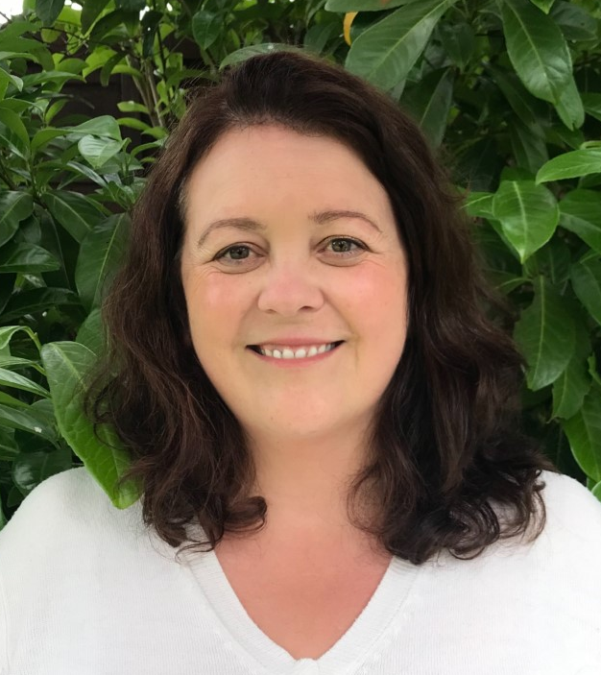
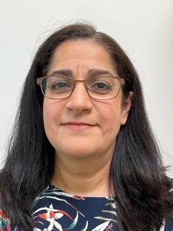
MEET THE TEAM
Squirrels
Mrs Chinchen Mrs Farjadpour

Slide 4
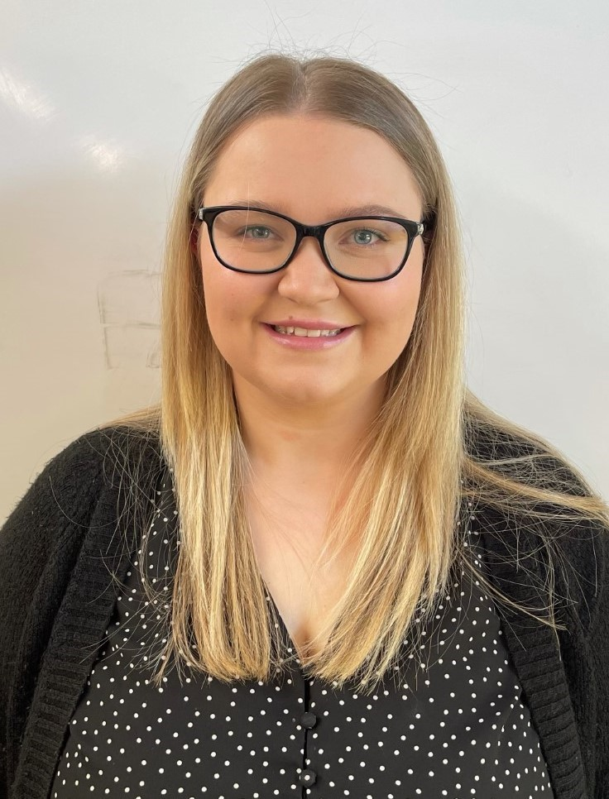
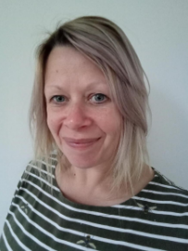
MEET THE TEAM
Badgers
Miss Bush Mrs Broadley

Slide 5
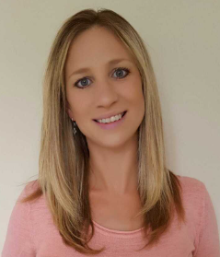
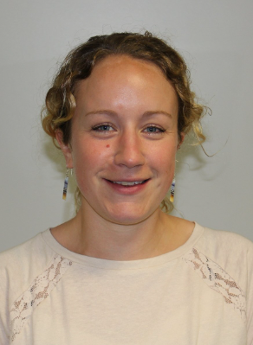
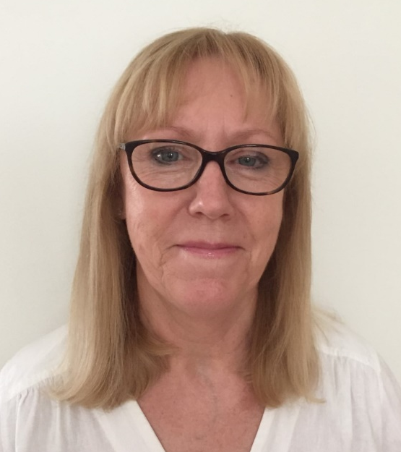
MEET THE TEAM
Owls
Mrs Miles Mrs Galloway Mrs Miller

Slide 6
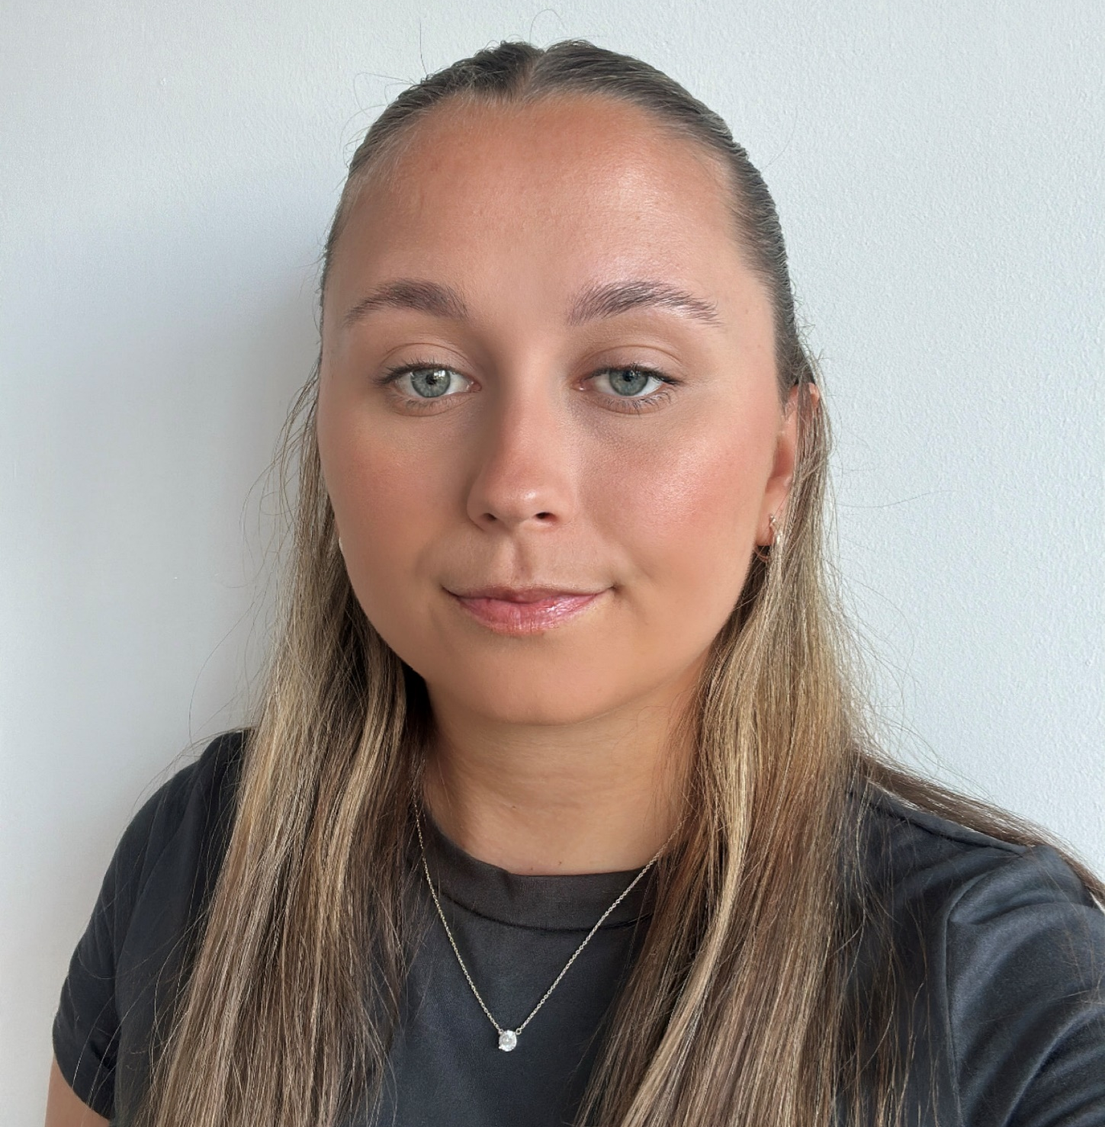
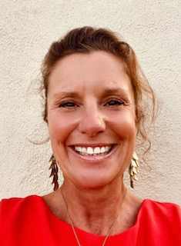
MEET THE TEAM
Hedgehogs
Miss Jones Mrs Collett

Slide 7
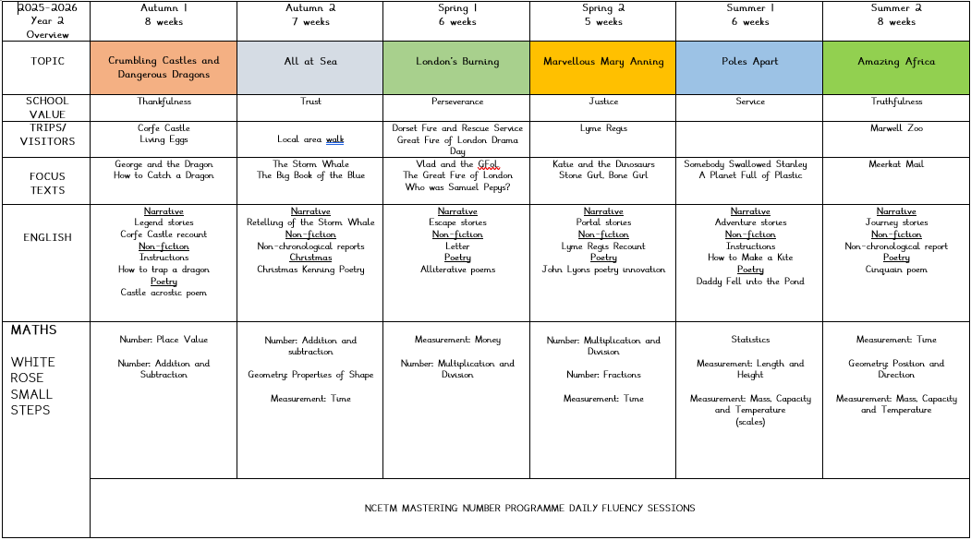
CURRICULUM OVERVIEW
A copy of our year plan can be found on our website.
Crumbling Castles and
Dangerous Dragons
All at Sea
London’s Burning
Marvellous Mary Anning
Poles Apart
Amazing Africa

Slide 8
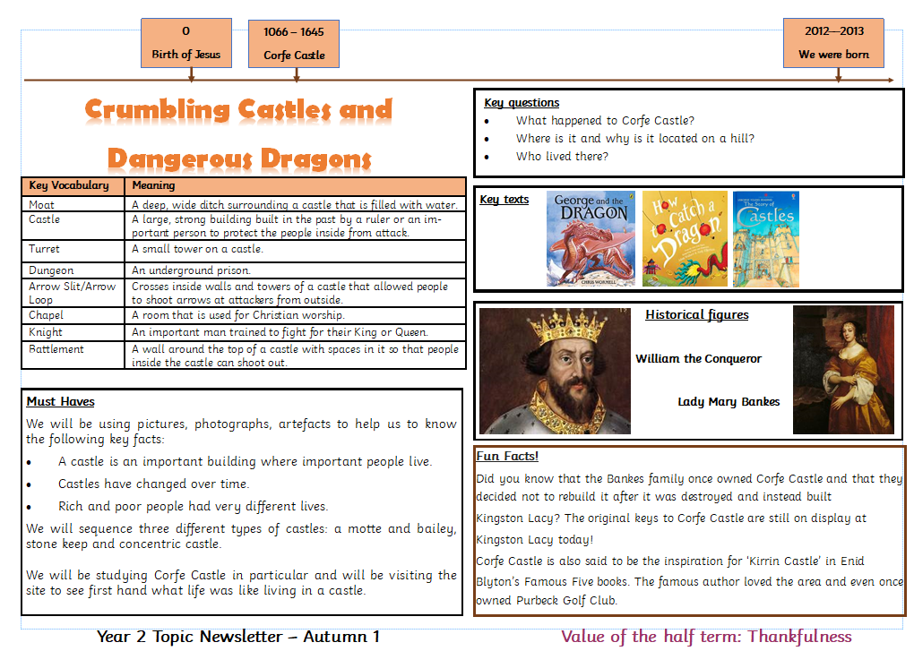
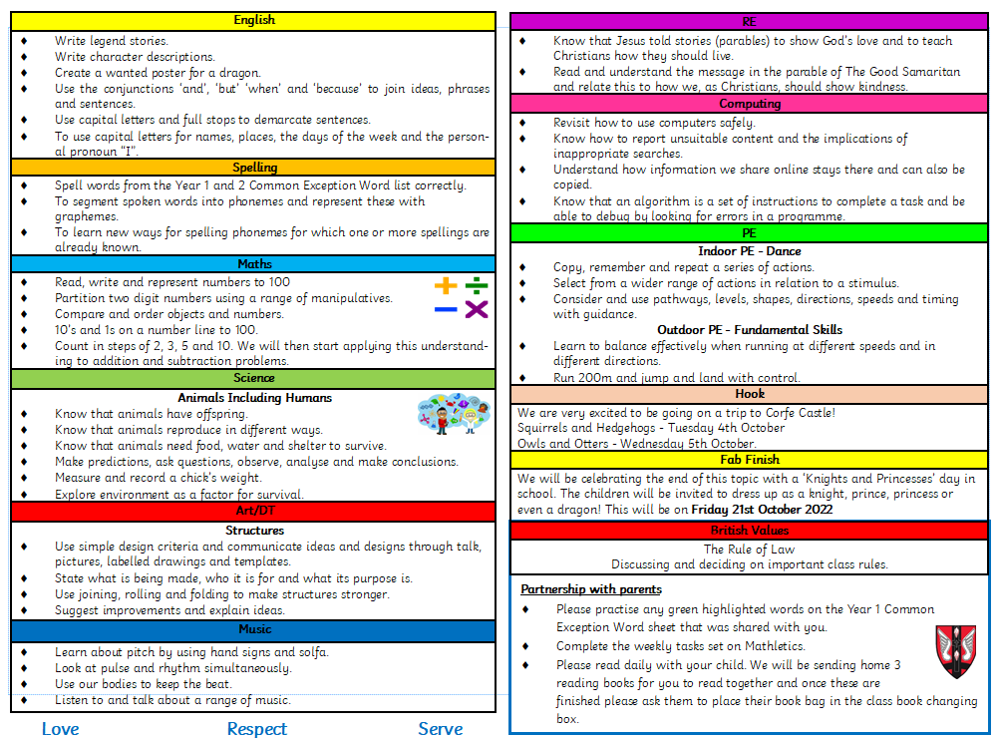
More detailed topic newsletters will also be available every half term on our website.

Slide 9
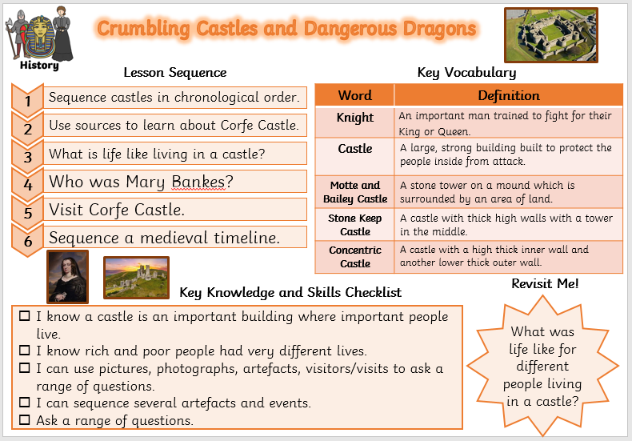
The children have book plates in their booklets so that they know the sequence of learning, the key vocabulary and ‘must have’ knowledge they will need to learn.

Slide 10
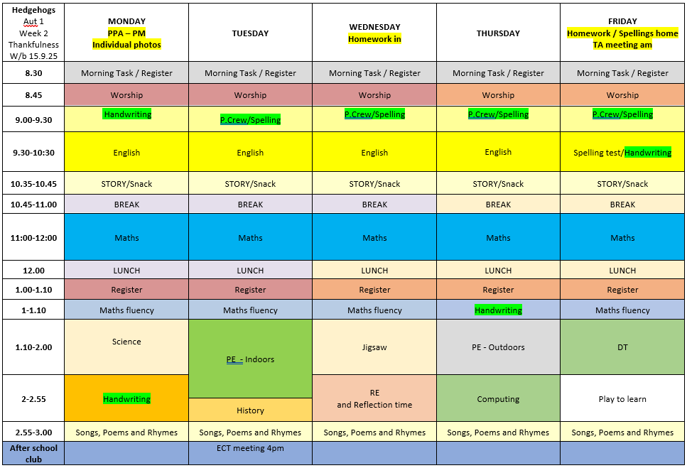
A typical weekly timetable
PE days for Year 2 are Tuesday and Thursday.

Slide 11
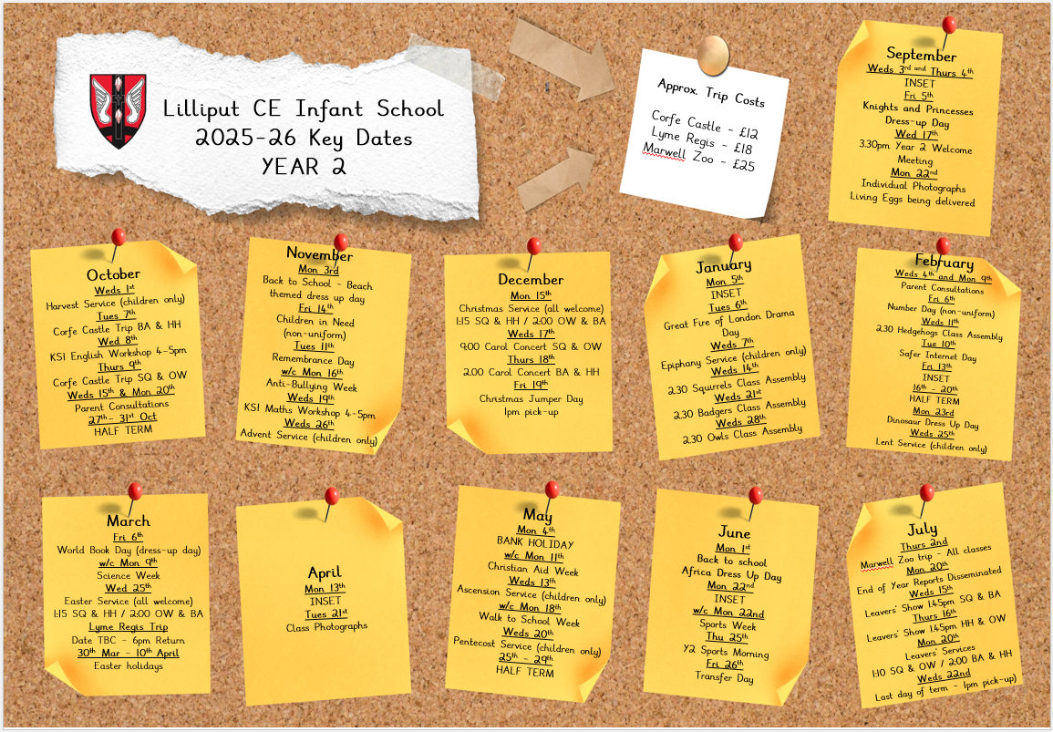
Key dates
Notes:
KC

Slide 12
Trips
Corfe Castle (£11.91)
Badgers and Hedgehogs – Tuesday 7th October 2025
Squirrels and Owls – Thursday 9th October 2025
Lyme Regis (Approx £20)
March (Date tbc due to tide times) – Extended school day till 6pm
Marwell Zoo (Approx £25)
All classes – Tuesday 2nd July – Extended school day till 5pm
Notes:
KC

Slide 13
Performances
Class assembly dates are on the yearly diary dates but all start at 2.30pm in the school hall on the following dates:
Squirrels Wednesday 14th January
Badgers Wednesday 21st January
Owls Wednesday 28th January
Hedgehogs Wednesday 11th February
There will be a Christmas Carol Concert led by Year 2 in the hall in December and an end of year Leavers Service and show in July.
Notes:
KC

Slide 14
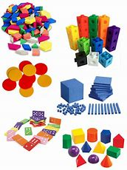
Maths in Year 2
We follow a CPA (Concrete-Pictorial-Abstract) approach to the teaching of Maths and have a wide variety of manipulatives available for the children to use.
Number and Place Value
Addition & Subtraction
Properties of shape
Money
Multiplication & Division
Measurement – Length, Height, Mass, Capacity and Temperature
Fractions
Time
Statistics
Position and direction
Notes:
KC What your child will learn in Y2 – please take a look at the curriculum documents on the school web site -
A Maths evening will announced shortly and recorded for you to watch at your leisure for all year groups SR
We always build on Year 1 learning and we always spend time identifying any gaps in learning when the year 1s join year 2 – this year is no different – we start where the children are and build confidence and skills

Slide 15

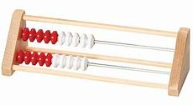
Mastering Number Programme
In addition to our Maths lessons we also develop the children’s fluency and number sense by teaching the Mastering Number Programme. These are 10-15 minute session four times a week.
This not only enables children to be confident in recalling their number bonds, halves, doubles and subitising skills but it also exposes them to the structures and patterns that are present in Maths.
The programme introduces the Rekenrek to pupils.
Notes:
KC What your child will learn in Y2 – please take a look at the curriculum documents on the school web site -
A Maths evening will announced shortly and recorded for you to watch at your leisure for all year groups SR
We always build on Year 1 learning and we always spend time identifying any gaps in learning when the year 1s join year 2 – this year is no different – we start where the children are and build confidence and skills

Slide 16
Writing in Year 2
Focus for Year 2
Cursive handwriting
SPAG
Spelling
Punctuation
And
Grammar
Writing genres
Poetry
Recounts
Narrative stories
Instructions
Non-chronological reports
Notes:
BB - Mastery approach to writing – children able to transfer writing skills from English across all subjects and genres. Learning is totally embedded.
Learn skills – spelling, punctuation and grammar
Apply in creative contexts SR

Slide 17
Reading in Year 2
We teach reading skills in our English morning lessons.
It is our aim to hear your child read a minimum of once a week. We will read with your child more frequently if we feel they need additional support in developing their decoding skills.
We regularly complete miscue assessments to accurately match a child’s reading book to their ability. This also informs us as to when children are ready to move up to the next reading box level.
We visit the library regularly and issue each child with a library book.
Notes:
BB - Please read the guidance in the books before starting a reading session MS
Don’t expect children to read a book a night or all 3 books in the week!
Check any words at the bottom of the page

Slide 18
Home Reading
You will see that we will no longer be recording reading comments in home reading records as these are for you to use with your child. Please make sure you read a minimum of three times a week for around 10 minutes each time with your child and record this in their reading record.
In Year 2 we send home 3 books at a time. Once you have read all three of these books and your child is reading them fluently without the need to decode, please write that they have finished all three in the reading record to indicate to us that they are ready to have them changed on their box colour day.
Monday - Red Group
Tuesday – Blue Group
Wednesday – Green Group
Thursday - Yellow Group
Friday - Purple Group
Please ask your child to place their book bag in the correct colour box every morning.
Mrs Chambers’ Reading Challenge
Notes:
BB - Please read the guidance in the books before starting a reading session MS
Don’t expect children to read a book a night or all 3 books in the week!
Check any words at the bottom of the page

Slide 19
Assessment and Marking
  Highlighting – pink (for positive), green (for areas of improvement) and blue (for challenge)
  Green highlighted spellings are practised three times on the given lines.
  All work is presumed to be independently completed unless marked with T (Teacher assisted) or TA (Teaching Assistant assisted)
  Assessment
  Year 1 phonics retake screening – June
  Non-statutory end of Key Stage 1 Assessments will take place in May.
  We will discuss your child’s progress and next steps during parents evening and through their reports.
Notes:
CP End of KS1 – Year 1 phonics screening will now take place in Autumn 2 – we will be working closely with your child to ensure they are secure in their phonic knowledge. Some support may be be sent home. Children who don’t pass will have some extra sessions in school and parents will be kept fully informed and supported ☺
Teacher assessment supported by tests and tasks – Please don’t worry about these – they form part of our on going assessment and the children really enjoy them!
Parents evenings slide next

Slide 20
Interventions
Interventions take place across Year 2 to address any gaps in learning that the children may have.
We currently have a Maths, Reading, Phonics, ELSA and Speech and Language interventions in place.
Those children who are still to pass the Year 1 Phonics Screening Check will be given another opportunity to complete this assessment in June. They will be in Phonics Crew led by Mrs Miles and Mrs Galloway and will receive a daily phonics lesson four mornings a week. Phonics mats are shared with parents so that you can complete daily practises of these sounds.
Notes:
KC We want your children to love coming to school and we do our very best to plan and deliver fun, exciting and challenging topics throughout Year 2.
From the minute they come into school your child should feel safe and secure, ready to take risks and confident in their ability to learn.

Slide 21

Our school vision and values
We come together for an act of daily collective worship in the school hall led by a member of the SLT.
On Friday we celebrate the children’s successes in our Star of the Week assembly. ☺

Slide 22
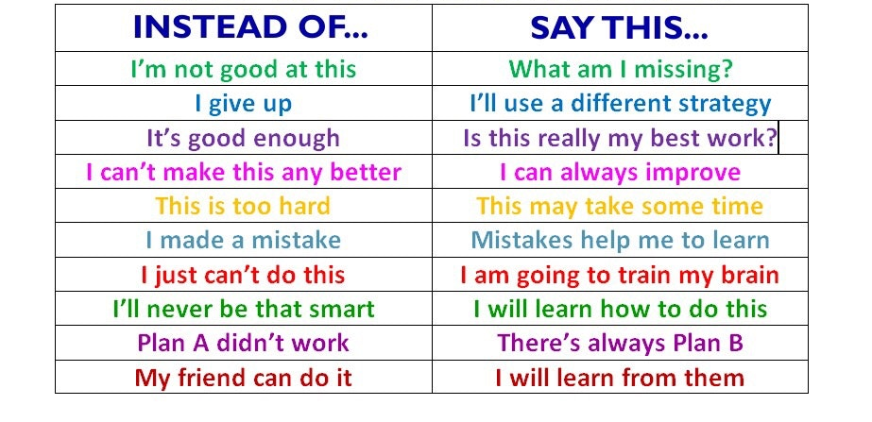
We encourage children to have a growth mindset, to be resilient and to learn from their mistakes.
The children are given opportunities to take on extra responsibilities throughout the year.
We have daily helper jobs and the Year 2 children can apply to be a School Councillor, Green Ambassador, Lunchtime Helper or a Sports Leader to further develop their leadership and collaborative skills.

Slide 23
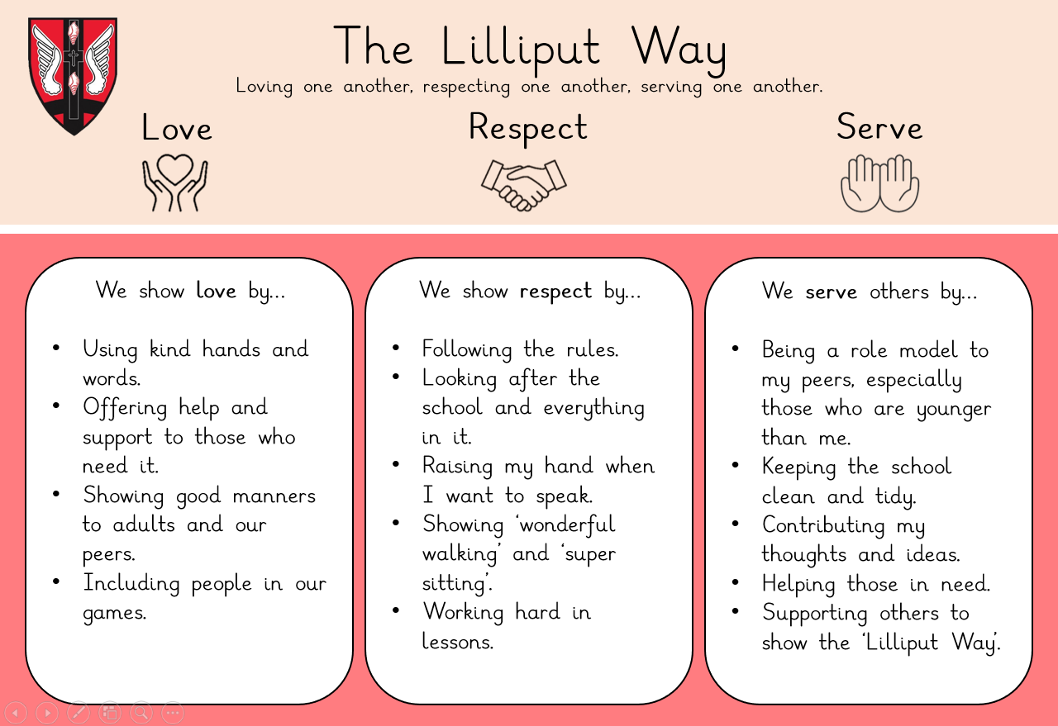
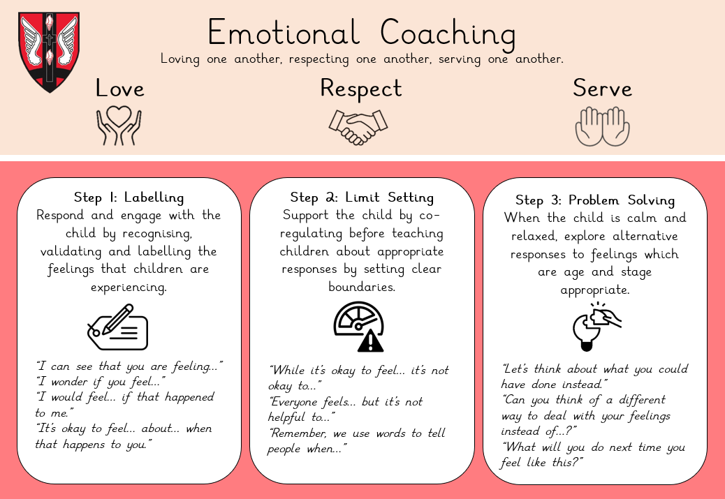
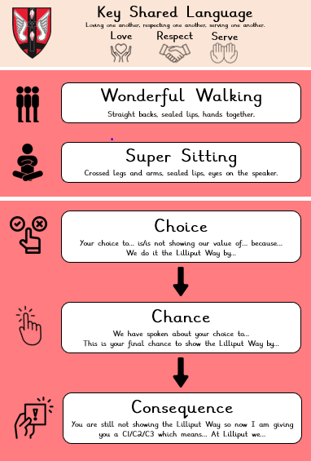
Our behaviour policy
Notes:
KC We are very proud of our positive approach to behaviour management at school. This is achieved through praise and careful reward systems.
Our behaviour policy includes the use of the child-led behaviour books to record when a child has forgotten one of the school rules that we have all agreed on. This is a tool, not a threat and the children understand that this is a way of learning about and improving behaviour so that everyone feels safe and happy at school.

Slide 24
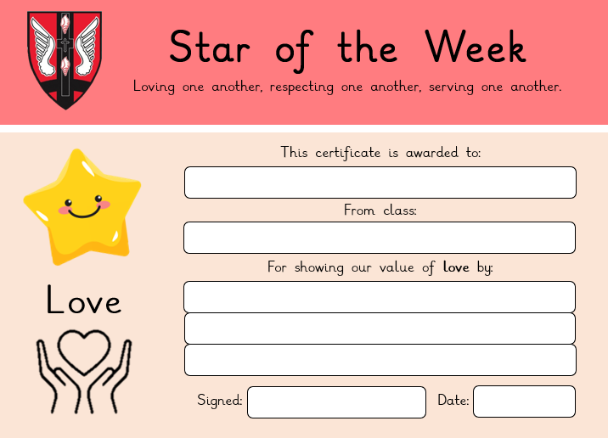
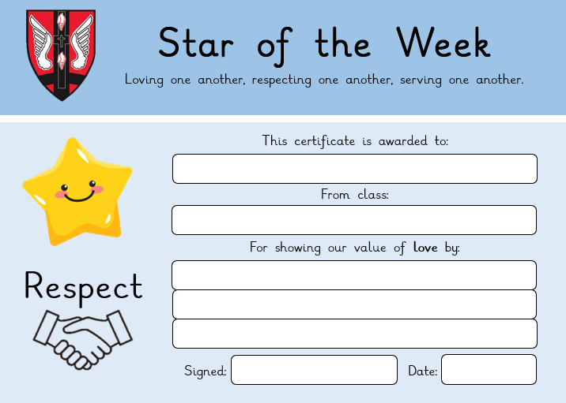
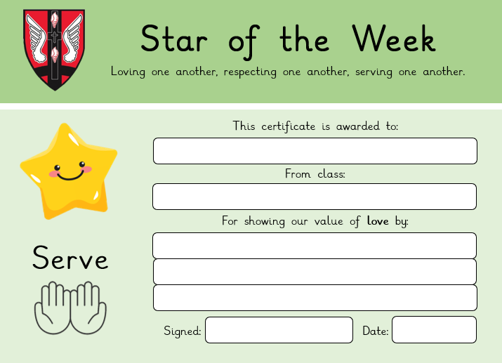
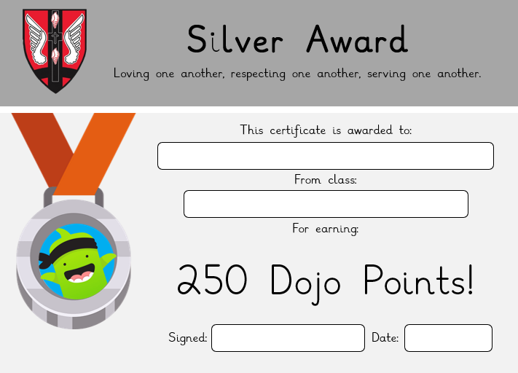
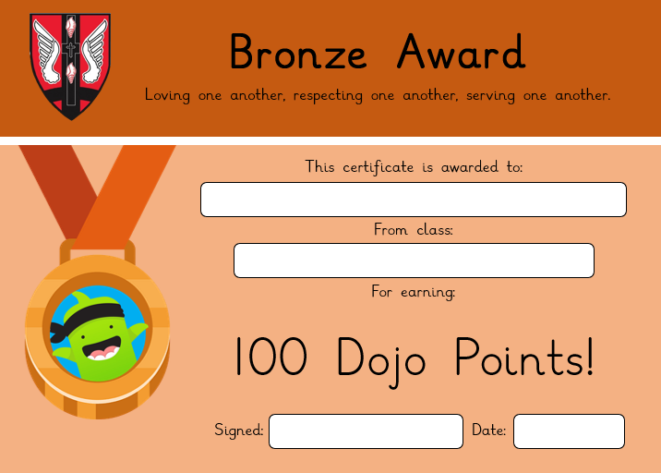
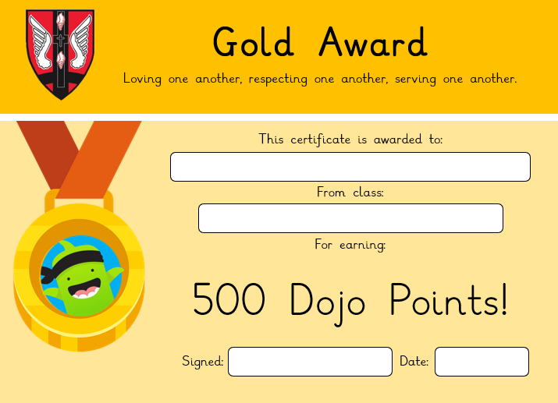
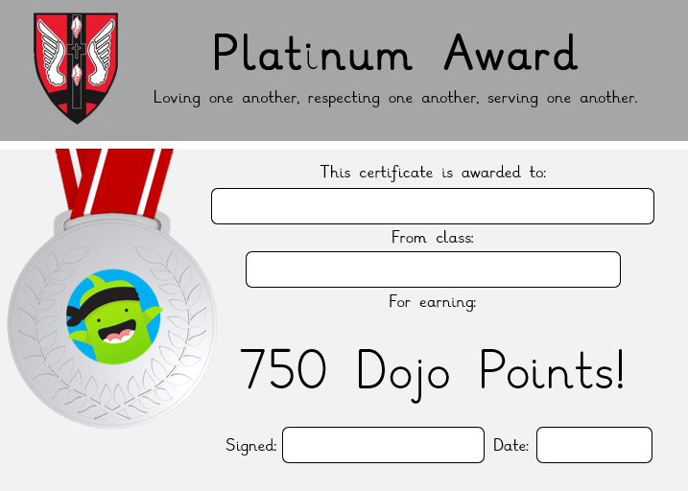
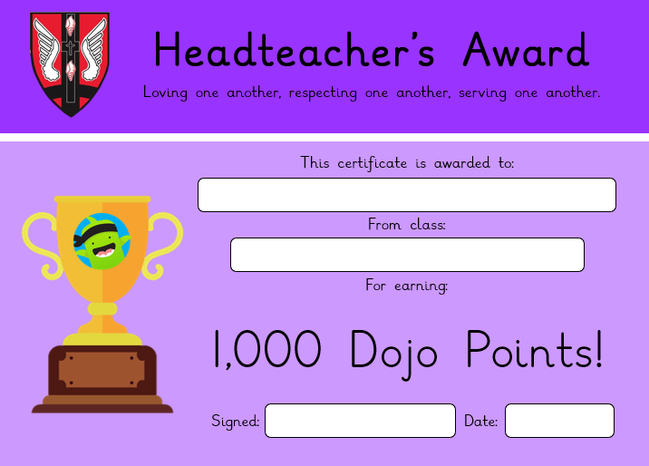
Rewards
Star of the Week (linked to our core values of love, respect, serve)
Dojo points are given and totalled up at the end of the week. The winning class with the most amount of Dojo points receive extra playtime.
Dojo points are also tracked and milestones
(100, 250, 500, 750, 1000+) are awarded to individual children.
Notes:
KC We are very proud of our positive approach to behaviour management at school. This is achieved through praise and careful reward systems.
Our behaviour policy includes the use of the child-led behaviour books to record when a child has forgotten one of the school rules that we have all agreed on. This is a tool, not a threat and the children understand that this is a way of learning about and improving behaviour so that everyone feels safe and happy at school.

Slide 25
Rewards
Class Mascots – These are sent home every Friday. Please fill in the diary so your child can share their adventures with their mascot back in class. Please do not include any photos of your child in these books.
Sports Person of the half term
Notes:
KC We are very proud of our positive approach to behaviour management at school. This is achieved through praise and careful reward systems.
Our behaviour policy includes the use of the child-led behaviour books to record when a child has forgotten one of the school rules that we have all agreed on. This is a tool, not a threat and the children understand that this is a way of learning about and improving behaviour so that everyone feels safe and happy at school.

Slide 26
Homework
A piece of English or Maths homework will be sent home every Friday. It is due in on the following Wednesday but please do bring it in earlier if it has been completed. Please write a comment on the work if you supported your child, otherwise we will assume it was independent.
Spellings will be set weekly and children will be tested on these on a Friday. There are three columns in their booklets for them to practise their spellings a minimum of three times throughout the week ahead of the test.
Homework should take approximately 30 minutes to complete. It is linked to the learning in school so that the children can discuss this with you and consolidate their understanding. They should be able to complete it independently as it is previously studied content.
Mathletics tasks are set weekly and again tie in with our curriculum. Children who play regularly and earn enough points receive Mathletics certificates (bronze, silver and gold).
Notes:
SO Homework is for children to practise and consolidate what we have been learning in school that particular week. It will not always be recorded – sometimes it will be a practical activity.
Homework will be looked at, valued, discussed and sometimes displayed. Consolidation.
Homework will be marked and returned. About 30 mins.

Slide 27
Housekeeping
Book bags – please ensure you empty your child’s book bag every night. They are allowed one small keyring attached to their book bags as we don’t have the storage space for large toys or multiple key rings to be attached.
If your child is being collected by someone not on their going home form, please make sure you have informed the office, especially if they are going to a club.
Hair longer than shoulder length must be tied up for both boys and girls.
Water bottles can be purchased from the school office and will be labelled in class. Please ensure your child has their water bottle in school every day – this needs to be a school water bottle and only contain water.
Please avoid bringing in personal items from home eg toys, cards, cuddly toys.
Notes:
KC

Slide 28
Housekeeping
Please name all uniform and PE kits, especially jumpers/cardigans, hats, coats, scarves and gloves!
PE kits should be worn on your child’s PE days. If it looks like rain, please ensure that your child has a raincoat as well. When the weather gets colder, please ensure that they have warm jogging bottoms, coat, etc as we still go outside!
Any earrings must be studs only. These must be removed or taped at home on PE days. Please do not send your child in with any jewellery/wrist bands etc. No smart watches please.
Notes:
KC

Slide 29
Attendance
Children do better if they attend school regularly.
A child with 96% attendance has actually missed nearly 10 days of school.
Attendance is monitored at Lilliput and parents will be contacted when their child’s attendance dips below 95%.
Mrs Chambers will only grant leave of absence from school in exceptional circumstances (defined as rare, significant, unavoidable and short).
Requests should be made using the Request for Leave of Absence form available on the website or at the office. These must be submitted before any absence is taken.
Family holidays/breaks and family birthdays are not considered ‘exceptional’.
Absences that are not agreed should not be taken. The Local Authority will issue fines for such unauthorised absences.
Notes:
KC

Slide 30
Pupil Premium Funding
The Pupil Premium grant paid to schools is a government initiative designed to target resources to those pupils deemed to be from a disadvantaged background.
The 2025 - 26 grant is made up of the following for eligible pupils:
- Pupils eligible for free school meals in the last 6 years - £1,515
- Looked After Children - £2,630 (Pupil Premium Plus)
- Children adopted from care - £2,630
- Children from families with parents in the armed forces - £350
We use the grant in a number of ways to ensure it benefits eligible children in order to help them achieve their potential both academically and socially. The main ways in which the money is spent is:
To fund or part-fund the provision of Teaching Assistant support for individuals, small groups and classes to help children achieve their academic potential.
To fund the provision of specific resources and academic interventions to support and improve achievement.
To fund the provision of Teaching Assistant support for non-academic interventions such as ELSA and Forest School sessions to help increase self-esteem, develop social skills, improve relationships and confidence etc.
To subsidise school trips, Creative Club before and after school, uniform, extra-curricular clubs, milk subscriptions, visitors and performers to school.
Notes:
KC

Slide 31
Who can apply for Pupil Premium funding?
Your child might be able to get free school meals if you get any of the following:
Income Support
Income-based Jobseeker’s Allowance
Income-related Employment and Support Allowance
Support under Part VI of the Immigration and Asylum Act 1999
The guaranteed element of Pension Credit
Child Tax Credit (provided you’re not also entitled to Working Tax Credit. You must also have an annual gross income of no more than £16,190)
Working Tax Credit run-on - paid for 4 weeks after you stop qualifying for Working Tax Credit
Universal Credit - if you apply on or after 1 April 2018, your household income must be less than £7,400 a year (after tax and not including any benefits you get)
You can find more information on how we specifically spend this funding on our website under the Pupil Premium tab which also includes a link to the BCP Council’s application page.
Notes:
KC

Slide 32
Communication
If you would like a quick word then please speak to your class teacher after school.
If you require a longer discussion, please email the year leader email Year2Lead@lilliput.coastalpartnership.co.uk to arrange an appointment.
Notes:
KC

Slide 33
Thank you for joining us today!
Do you have any questions?
Notes:
KC

