Slide 1

Lilliput C of E Infant School
Loving one another, respecting one another, serving one another.
Wednesday 19th November 2025
KS1 Maths Workshop

Slide 2
Numberless
If all the numbers in the world were rubbed out,
removed, taken away:
I wouldn’t know how old I was,
I wouldn’t know the time of day,
I wouldn’t know which bus to catch,
I wouldn’t know the number of goals I had scored,
I wouldn’t know how many scoops of ice-cream I had,
I wouldn’t know the page on my reading book,
I wouldn’t know how tall I was,
I wouldn’t know how much I weighed,
I wouldn’t know how many sides there are in a hexagon,
I wouldn’t know how many days are in the month,
I wouldn’t be able to work my calculator.
And I wouldn’t be able to play hide-and-seek!
But I would know
As far as my mum was concerned,
I was still her NUMBER ONE!
Ian Souter

Slide 3
Perception of Maths
What is your experience of maths at school?
If children hear ‘I hate maths’ or ‘I can’t do Maths’ then
perceptions start to become negative and their barriers go up!
We all need to be positive role models about maths so that our children develop a love of this subject, recognising its value in the real world and see it as an area of the curriculum in which they can succeed.

Slide 4

AGENDA FOR THE SESSION
The National Curriculum
Our maths curriculum
A concrete, pictorial, abstract approach
White Rose small steps
Meet Tiny
Mastering Number
Calculation strategies
End of Key Stage 1 assessments
How to help at home
Questions

Slide 5
The National Curriculum
Aims for all pupils to…
become fluent in the fundamentals of mathematics, including through varied and frequent practice with increasingly complex problems over time, so that pupils develop conceptual understanding and the ability to recall and apply knowledge rapidly and accurately.
reason mathematically by following a line of enquiry, conjecturing relationships and generalisations, and developing an argument, justification or proof using mathematical language.
can solve problems by applying their mathematics to a variety of routine and non-routine problems with increasing sophistication, including breaking down problems into a series of simpler steps and persevering in seeking solutions.

Slide 6
KS1 Maths Curriculum
Our curriculum coverage includes…
Number and place value
Addition and subtraction
Multiplication and Division
Fractions
Measurement
Geometry
properties of shape / position and direction
Statistics (Year 2)
Our curriculum is designed so that pupils explore mathematical ideas in depth.

Slide 7
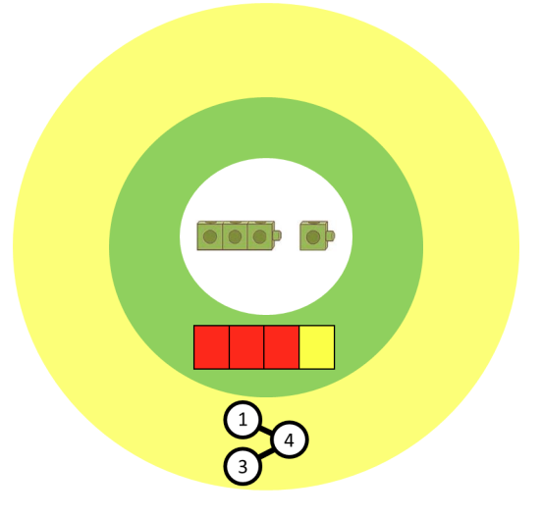
A CPA approach
Concrete
Manipulatives such as cubes, rekenreks, counters, Dienes and shapes are used at this stage.
Pictorial
Pictures and drawing are used to represent the manipulatives used.
Abstract
Numbers and symbols are now used.

Slide 8
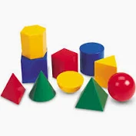
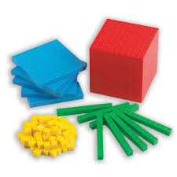

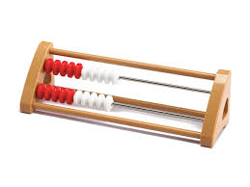

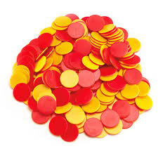
A CPA approach
Concrete
The concrete stage is the “doing” stage. Pupils are taught with the use of manipulatives and physical resources to physically show the process behind what is being taught. At its most basic level, this can be as simple as using counters, sweets, marbles, etc to show numbers/amounts, allowing children to visualise the idea of more or less or comprehend what 3 (or any given number) actually is.
All of the main mathematical operations can be introduced and explored in this way. You’ll find that learners love getting involved with this hands-on approach

Slide 9
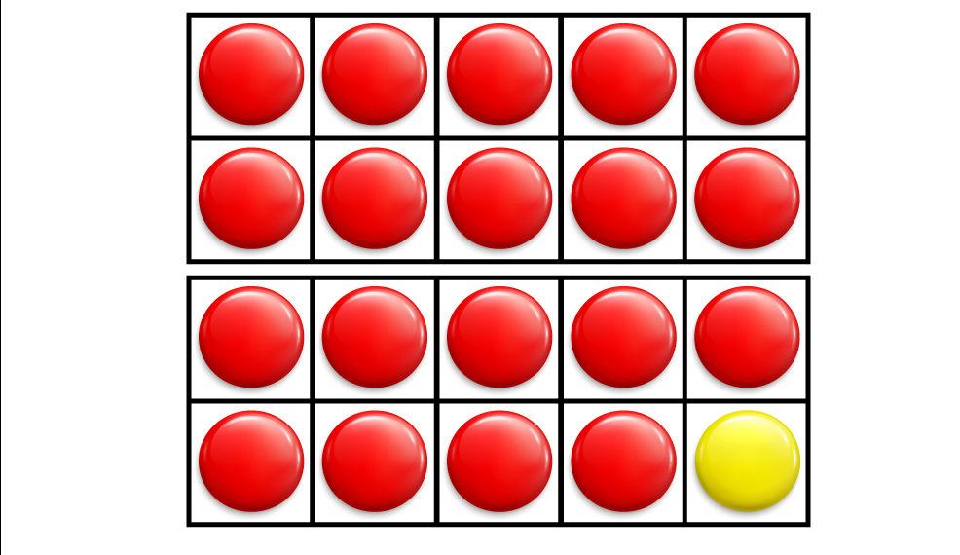
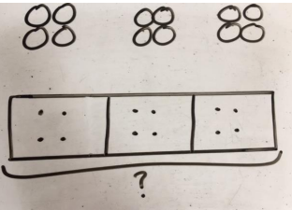
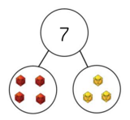
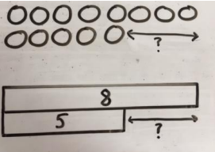
A CPA approach
Pictorial
Pictorial is the “seeing” stage. Here, visual representations of concrete objects are used to model problems. This stage encourages children to make a mental connection between the physical object they just handled and replace them with a pictorial representation. Additionally, visual support strategies such as ten frames, drawing Dienes, bar models and part whole representations are used for pupils to show their understanding by answering questions using these visuals.
The pictorial stage is essential for learners to consolidate and secure their understanding of topics. It bridges the gap between getting to grips with a concept (quite literally) and knowing how to combat more abstract ideas

Slide 10
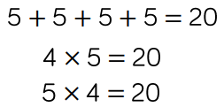
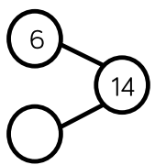
A CPA approach
Abstract
Abstract is the “symbolic” stage, where children use abstract symbols to model problems. Students will not progress to this stage until they have demonstrated that they have a solid understanding of the concrete and pictorial stages of the problem. The abstract stage involves the teacher introducing abstract concepts (for example, mathematical symbols). Children are introduced to the concept at a symbolic level, using only numbers, notation, and mathematical symbols (for example, +, –, x, /) to indicate addition, multiplication or division.
If children have entered into the abstract stage, before establishing secure links or points of reference as to what these numbers, operations or key words mean, they may well struggle here (“Miss, what does ‘divide’ mean?”)

Slide 11
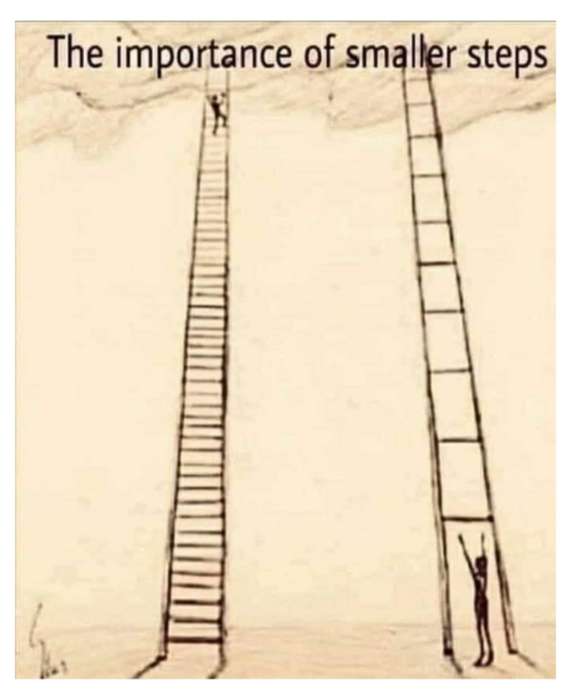
White Rose Maths
White Rose "small steps" are a teaching methodology that breaks down the national curriculum into smaller, more manageable learning objectives. Instead of tackling a large concept at once, students work through a series of these mini-steps, which builds understanding gradually and ensures each concept is mastered before moving on. This approach is used for subjects like maths and science and provides a coherent pathway through the curriculum.

Slide 12
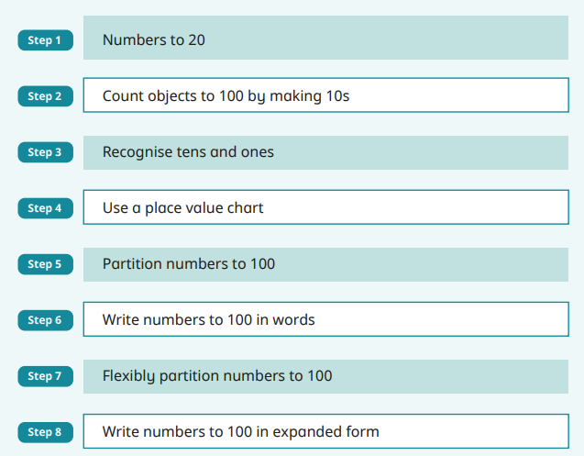
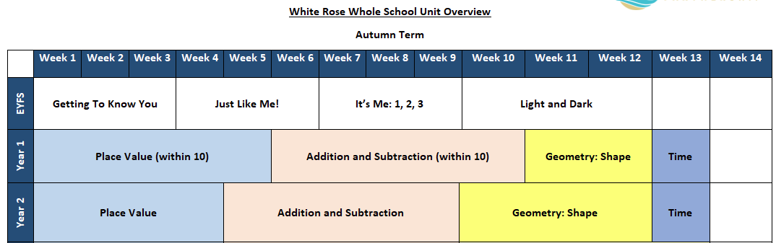
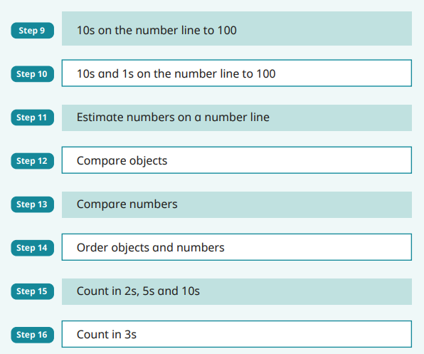
White Rose Maths Small Steps

Slide 13
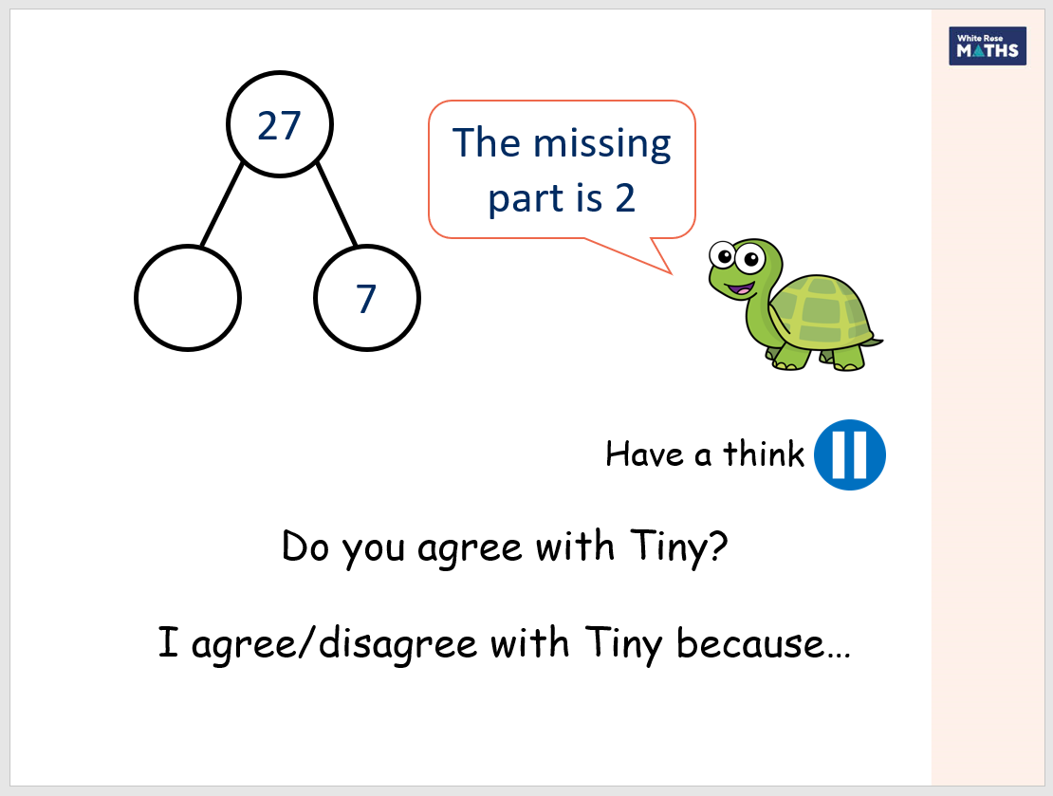

Meet Tiny

Slide 14

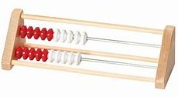
Mastering Number Programme
In addition to our Maths lessons we also develop the children’s fluency and number sense by teaching the Mastering Number Programme. These are 10-15 minute session four times a week.
This not only enables children to be confident in recalling their number bonds, halves, doubles and subitising skills but it also exposes them to the structures and patterns that are present in Maths.
The programme introduces the Rekenrek to pupils.
Notes:
KC What your child will learn in Y2 – please take a look at the curriculum documents on the school web site -
A Maths evening will announced shortly and recorded for you to watch at your leisure for all year groups SR
We always build on Year 1 learning and we always spend time identifying any gaps in learning when the year 1s join year 2 – this year is no different – we start where the children are and build confidence and skills

Slide 15
Addition and Subtraction Strategies
Column addition and subtraction isn't typically taught in KS1 because the focus is on building a strong foundation with mental math, partitioning numbers, and understanding place value through more concrete methods.
Introducing the formal column method too early can hinder a child's understanding of the underlying concepts and may lead to over-reliance on a written method before they are ready.
The formal written method is formally introduced from Year 3 onwards, as per the national curriculum.

Slide 16


Our Addition Strategy
26 + 31 =
When an addition doesn’t involve bridging (doesn’t cross over into the next ten) we encourage the children to draw tens and ones to help them.
26 + 38 = ?
20 + 30 = 50
6 + 8 = 14
50 + 14 = 64
When an addition does involve bridging (crosses over into the next ten) we encourage the children to split the two digit numbers into the tens and ones and then add these answers together in the last step.

Slide 17
Our strategy for working out subtraction
46 - 31 = 15
When a subtraction doesn’t involve exchanging (you can take away the ones in the second number from the ones in the first number) we encourage the children to draw tens and ones to represent the first number and then cross out the value of the second number to find the answer left.
52 - 38 = ?
When a subtraction does involve exchanging we teach the children to swap a ten stick for ten ones so that they can then cross out the correct amount.
52 - 38 = 14

Slide 18
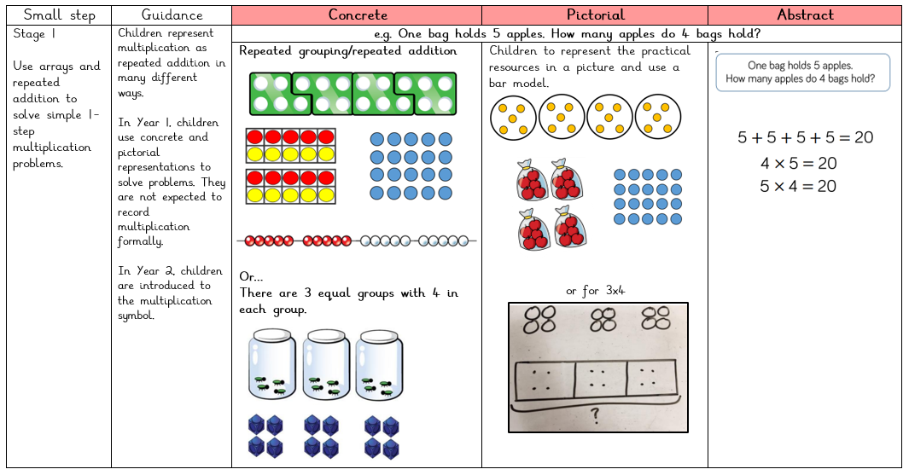
Multiplication

Slide 19
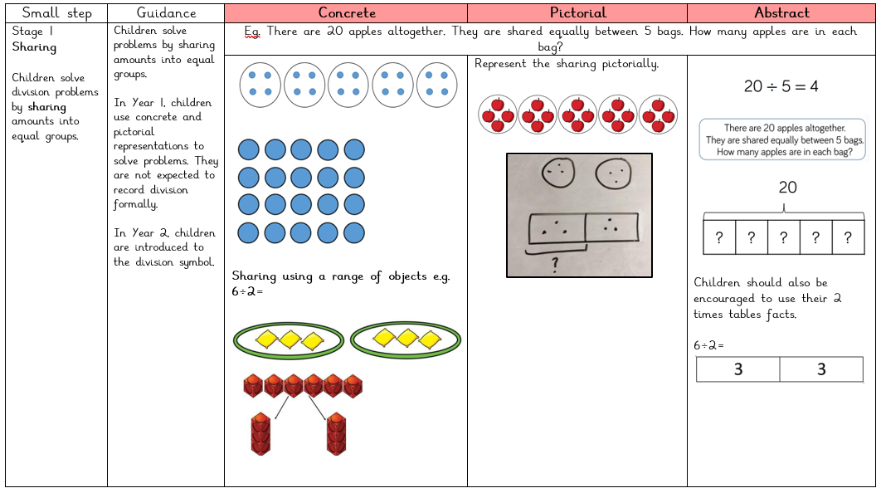
Division
Lilliput Calculation Policy

Slide 20
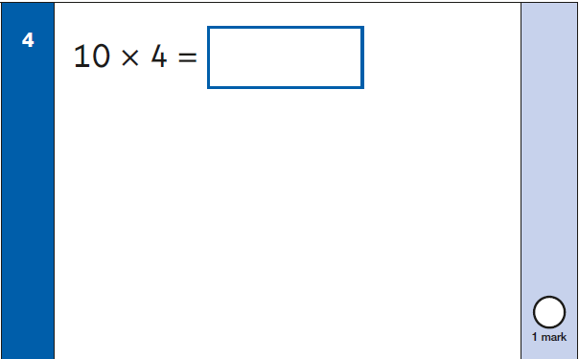
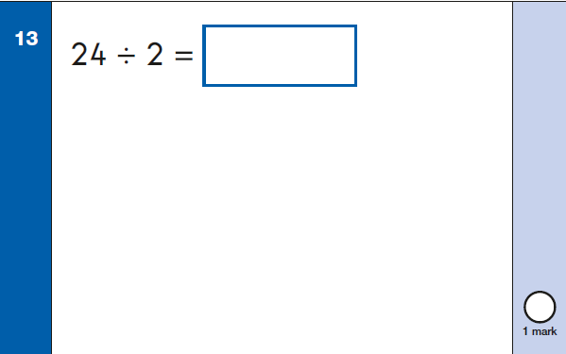
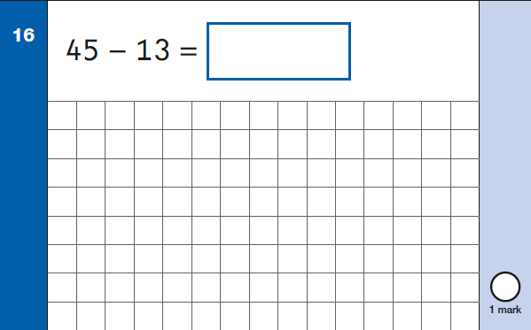
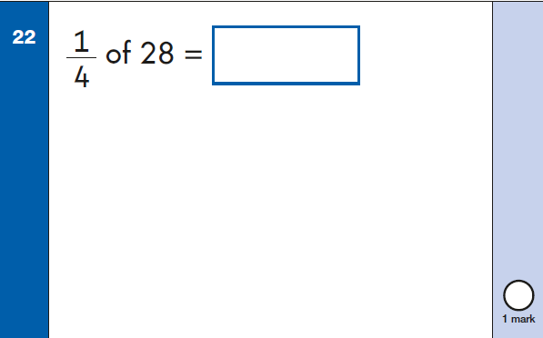
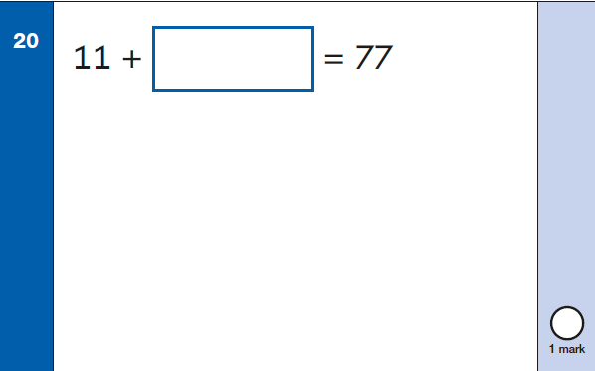
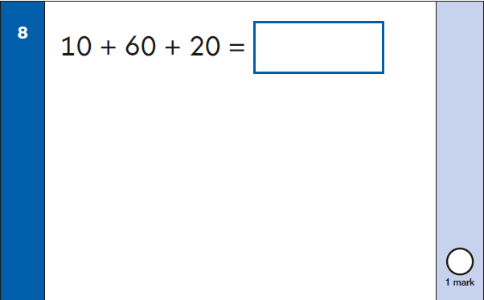
End of KS1 Maths Assessments
Arithmetic Paper
25 Questions that cover addition, subtraction, multiplication, division and fractions.

Slide 21
Reasoning Paper
35 questions spanning the whole KS1 mathematics curriculum.
There are also worded problem solving questions.
Questions can be read to the children.
The paper starts with 5 mental maths questions that are verbally read out by the teacher at the start.
Concrete materials are not available for the children to use but they can have a mirror and a ruler on their desks should they need to use these.

Slide 22
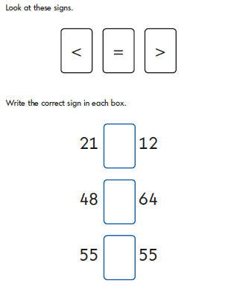
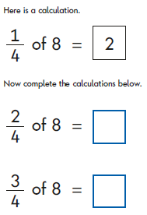
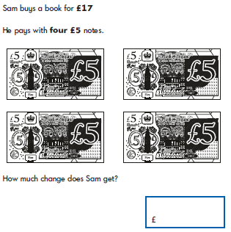
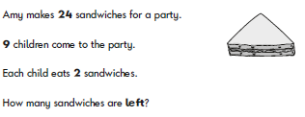
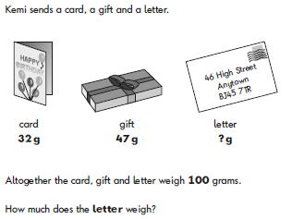
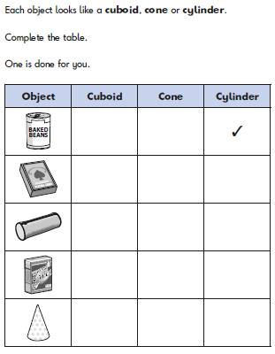
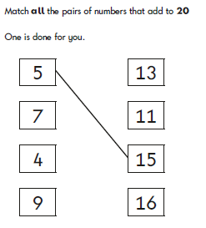
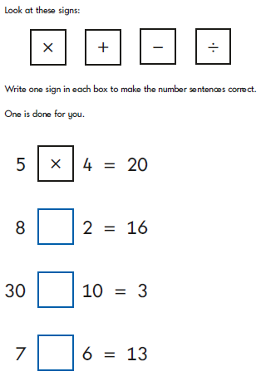
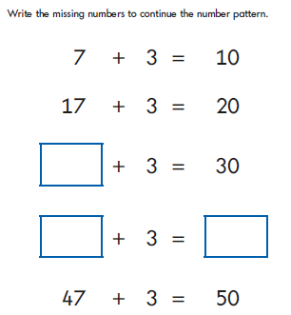

Slide 23


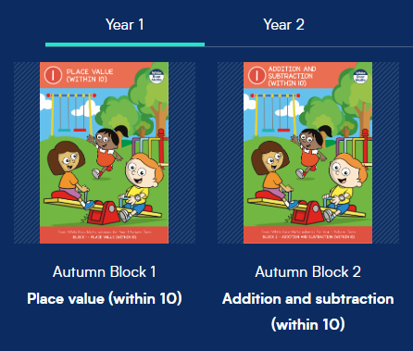
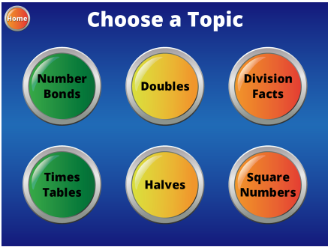

How to help at home
Free parent workbooks
Hit the Button
White Rose Parent Video Guides
Year 1
Count forwards and backwards
Number bonds to 10 then 20
Count in 2’s, 5’s and 10’s
Add and subtract a single digit
number from a 2-digit number
Tell the time using half past and o’clock
Recall doubles and halves
Year 2
Count forwards and backwards
Number bonds to 20
Learn the x2, x5 and x10 tables
and their division facts
Add and subtract two 2-digit numbers
Tell the time using quarter past and to
Recall doubles and halves

Slide 24


Thank you for coming!
Any questions?

