Slide 1

Lilliput C of E Infant School
Loving one another, respecting one another, serving one another.
Wednesday 19th November 2025
EYFS Maths Workshop

Slide 2
Numberless
If all the numbers in the world were rubbed out,
removed, taken away:
I wouldn’t know how old I was,
I wouldn’t know the time of day,
I wouldn’t know which bus to catch,
I wouldn’t know the number of goals I had scored,
I wouldn’t know how many scoops of ice-cream I had,
I wouldn’t know the page on my reading book,
I wouldn’t know how tall I was,
I wouldn’t know how much I weighed,
I wouldn’t know how many sides there are in a hexagon,
I wouldn’t know how many days are in the month,
I wouldn’t be able to work my calculator.
And I wouldn’t be able to play hide-and-seek!
But I would know
As far as my mum was concerned,
I was still her NUMBER ONE!
Ian Souter

Slide 3
Perception of Maths
What is your experience of maths at school?
If children hear ‘I hate maths’ or ‘I can’t do Maths’ then
perceptions start to become negative and their barriers go up!
We all need to be positive role models about maths so that our children develop a love of this subject, recognising its value in the real world and see it as an area of the curriculum in which they can succeed.

Slide 4

AGENDA FOR THE SESSION
The EYFS Curriculum
Our maths curriculum
A concrete, pictorial, abstract approach
White Rose small steps
Mastering Number
How to help at home
Questions

Slide 5
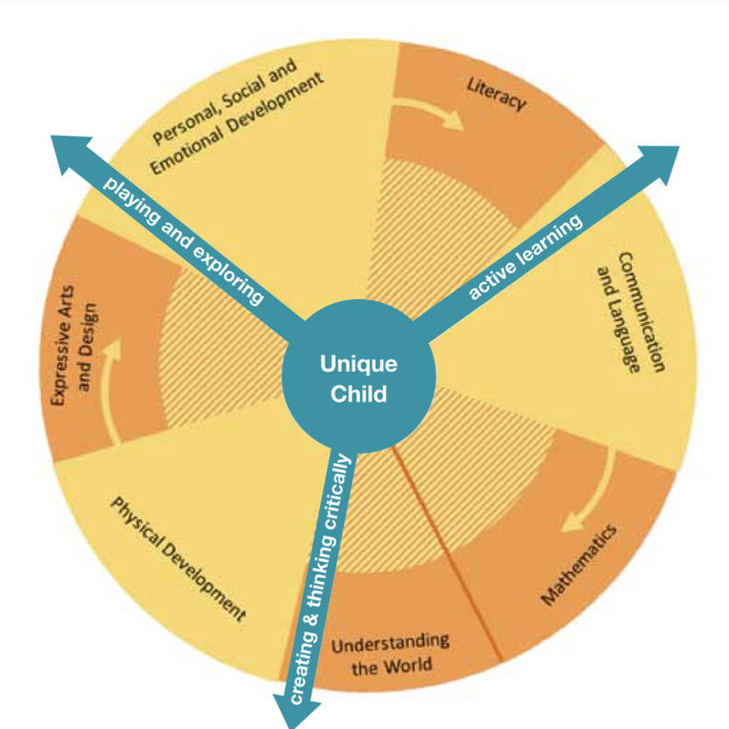
EYFS CURRICULUM
Your child will be learning skills, acquiring new knowledge and demonstrating their understanding through 7 areas of learning.
Children should mostly develop the 3 prime areas first.
These are:
• Communication and Language;
• Physical Development
• Personal, Social and Emotional Development.
As children grow and develop, the prime areas will help them to learn skills in 4 specific areas.
These are:
• Literacy
• Mathematics
• Understanding the World
• Expressive Arts and Design
These 7 areas of learning are broken down into 17 Early Learning Goals. The Early Learning Goals (ELGs) are the goals children are expected to achieve at the end of their reception year. They are not the curriculum, but an end point measure of what a child should be demonstrating at the end of the Early Years Foundation Stage before they start Year 1.
.

Slide 6
EY Foundation Stage Profile
The maths curriculum should allow children to…
Develop a strong grounding in number
Develop a deep understanding of the numbers to 10
Understand the relationships between numbers
Understand the patterns within numbers
Develop spatial reasoning skills, including within shape, space and measures

Slide 7
Early Learning Goal - Number
ELG: Number Children at the expected level of development will:
Have a deep understanding of number to 10, including the composition of each number;
At the end of YR the children need to be able to achieve this statement to get the ‘expected’ level. If they are below – then they will get ‘emerging

Slide 8
Early Learning Goal – Numerical Patterns
ELG: Number Children at the expected level of development will:
Verbally count beyond 20, recognising the pattern of the counting system;
Compare quantities up to 10 in different contexts, recognising when one quantity is greater than, less than or the same as the other quantity;
Explore and represent patterns within numbers up to 10, including evens and odds, double facts and how quantities can be distributed equally.
At the end of YR the children need to be able to achieve this statement to get the ‘expected’ level. If they are below – then they will get ‘emerging’.

Slide 9
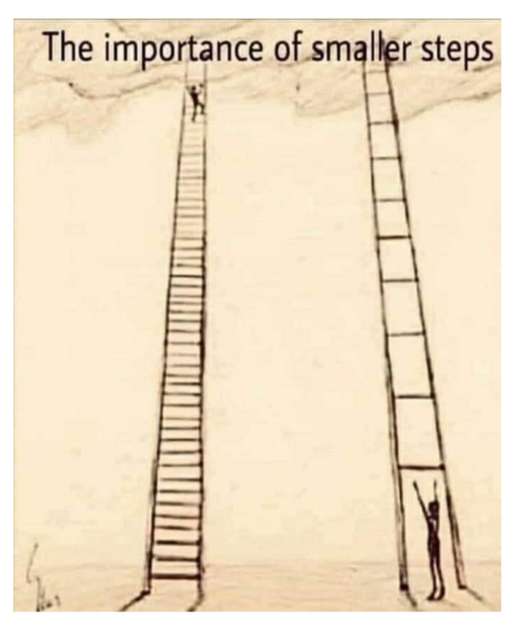
White Rose Maths
White Rose "small steps" are a teaching methodology that breaks down the national curriculum into smaller, more manageable learning objectives. Instead of tackling a large concept at once, students work through a series of these mini-steps, which builds understanding gradually and ensures each concept is mastered before moving on. This approach is used for subjects like maths and science and provides a coherent pathway through the curriculum.

Slide 10
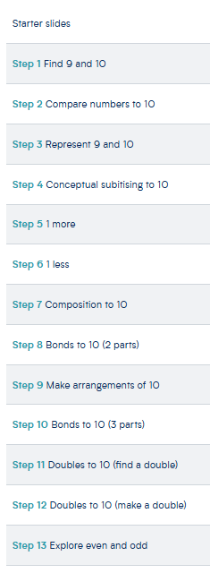
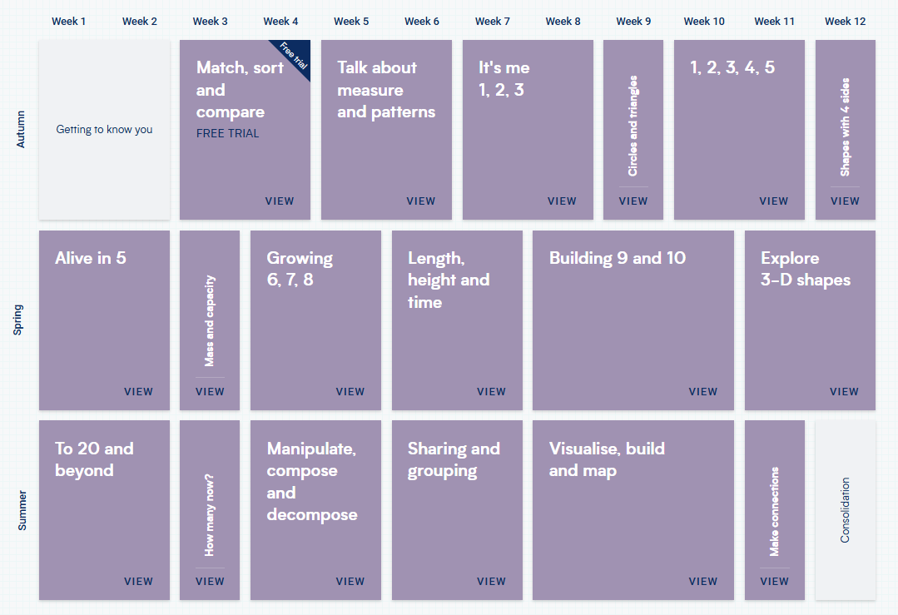
White Rose Maths Small Steps

Slide 11
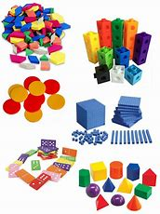
Maths in EYFS
We have 2 daily whole class teaching sessions.
We use ‘White Rose Maths’ and ‘Mastering Number’ as our schemes of work.
Adult led maths activity linked to the area of learning that week to support learning retention and next steps.
Each colour group will work with teacher and TA according to individual needs and targets as they change over the year.
Children apply learnt maths skills and knowledge in all areas of the classroom and outdoor provision in their ‘play to learn’ time. Adults support this through play.
Notes:
KC What your child will learn in Y2 – please take a look at the curriculum documents on the school web site -
A Maths evening will announced shortly and recorded for you to watch at your leisure for all year groups SR
We always build on Year 1 learning and we always spend time identifying any gaps in learning when the year 1s join year 2 – this year is no different – we start where the children are and build confidence and skills

Slide 12
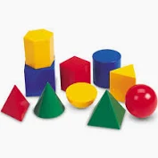
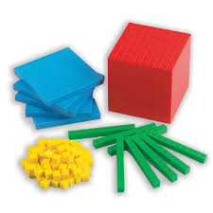

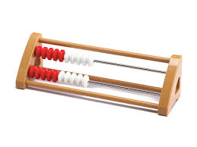

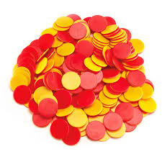
A CPA approach
Concrete
The concrete stage is the “doing” stage. Pupils are taught with the use of manipulatives and physical resources to physically show the process behind what is being taught. At its most basic level, this can be as simple as using counters, sweets, marbles, etc to show numbers/amounts, allowing children to visualise the idea of more or less or comprehend what 3 (or any given number) actually is.
All of the main mathematical operations can be introduced and explored in this way. You’ll find that learners love getting involved with this hands-on approach

Slide 13

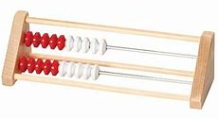
Mastering Number Programme
In addition to our Maths lessons we also develop the children’s fluency and number sense by teaching the Mastering Number Programme. These are 10-15 minute session four times a week.
This not only enables children to be confident in recalling their number bonds, halves, doubles and subitising skills but it also exposes them to the structures and patterns that are present in Maths.
The programme introduces the Rekenrek to pupils.
Notes:
KC What your child will learn in Y2 – please take a look at the curriculum documents on the school web site -
A Maths evening will announced shortly and recorded for you to watch at your leisure for all year groups SR
We always build on Year 1 learning and we always spend time identifying any gaps in learning when the year 1s join year 2 – this year is no different – we start where the children are and build confidence and skills

Slide 14
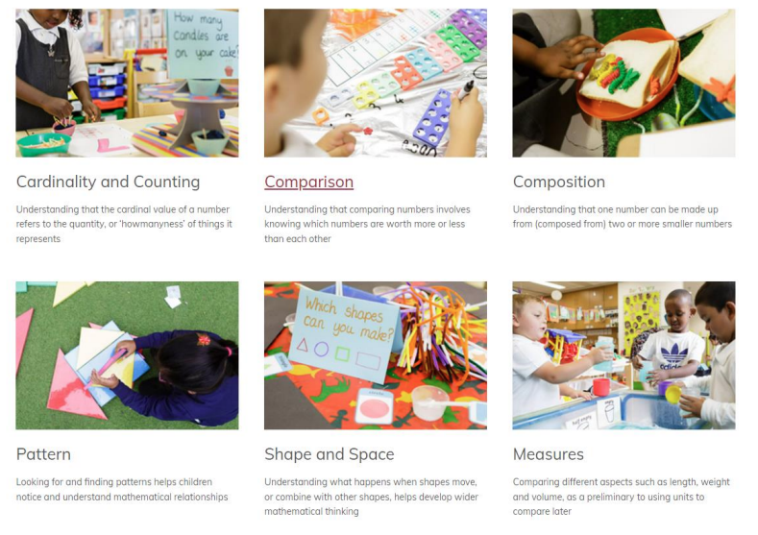
Fundamental Maths Concepts

Slide 15
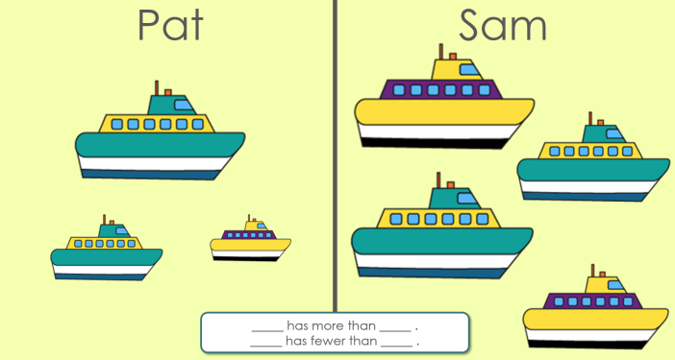
Comparison
Looking at and identifying which numbers are worth more and which are worth less.

Slide 16
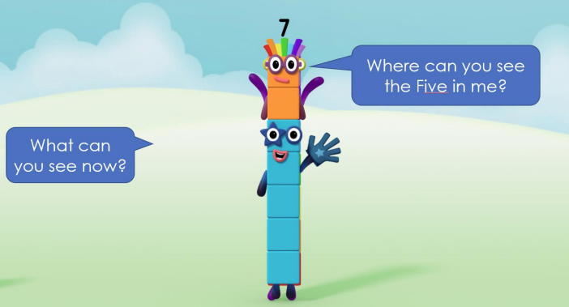
Composition
When we can see that numbers are made up of different numbers.

Slide 17
Pattern
Looking for and identifying patterns can help children understand mathematical concepts
Shape and Space
Understanding what happens when shapes move or combine with other shapes
Measure
Comparing different aspects such as length, weight and volume

Slide 18
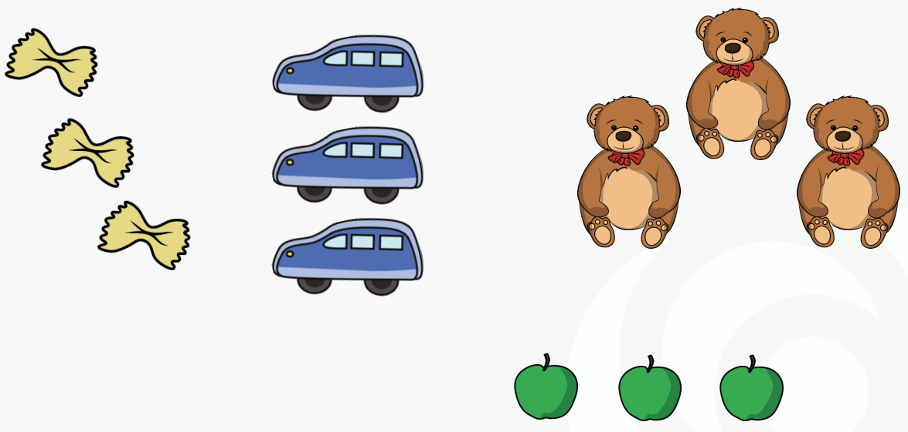
Subitising
Subitising is “instantly seeing how many”, taken from a Latin word meaning suddenly.
Clements (1999)

Slide 19

Subitising
Children are then encouraged to link this skill in their play to learn.

Slide 20
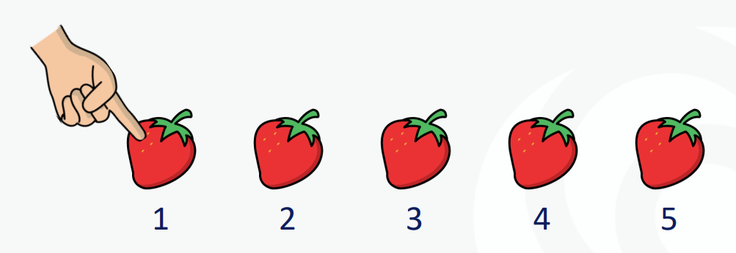
The one to one principle
Counting each item once and only once

Slide 21
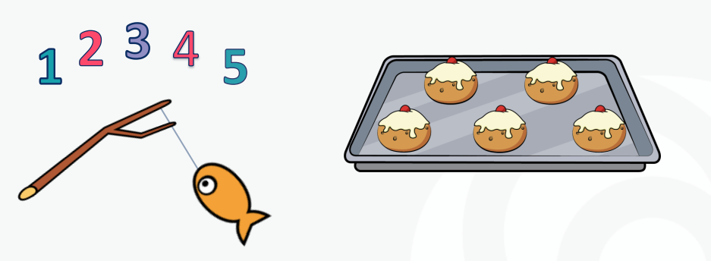
The stable order principle
Learning the sequence of number names

Slide 22
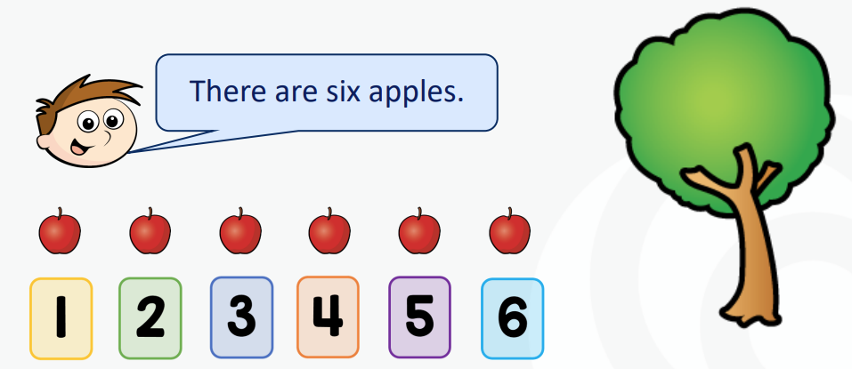

The cardinal principle
The last object counted gives the total quantity

Slide 23
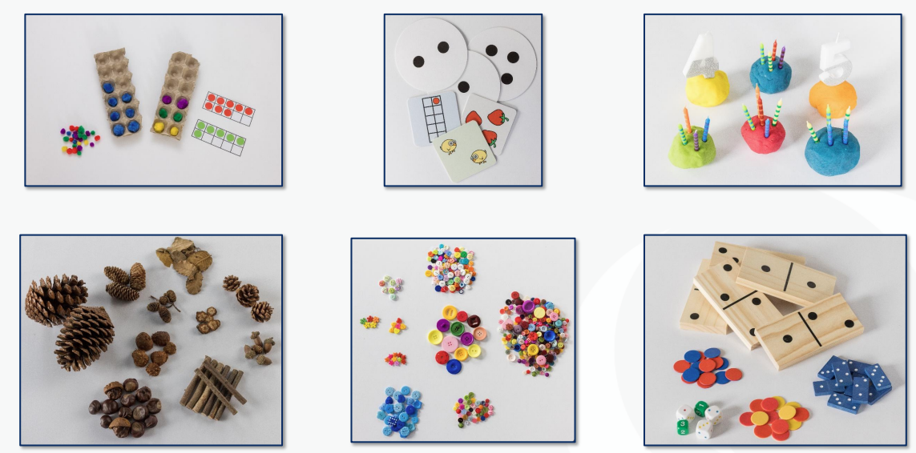
What maths look likes in EYFS
Lots of concrete resources are available!

Slide 24

What maths look likes in EYFS
Maths through stories

Slide 25
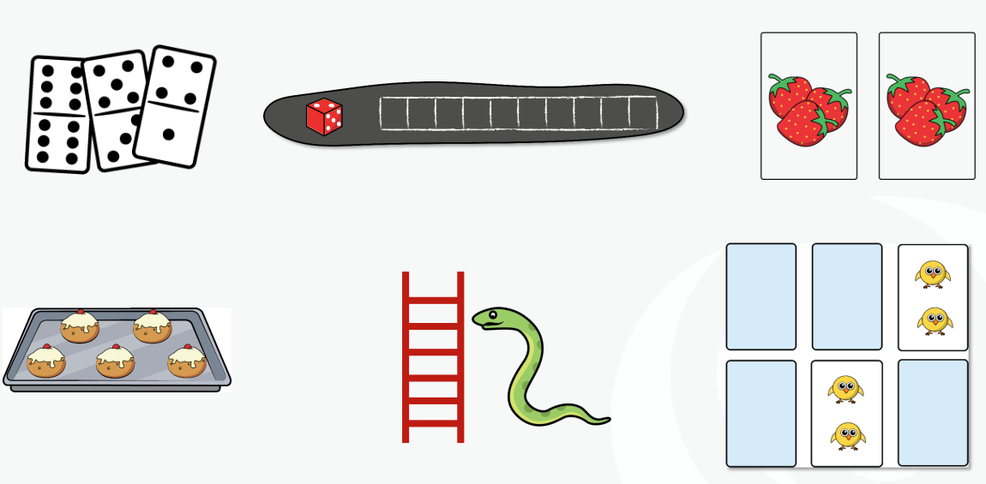
What maths look likes in EYFS
Games

Slide 26
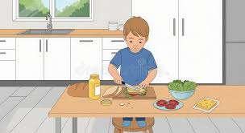
Preparing and eating food and drink
Set the table, does each person have a knife, fork, spoon, plate and cup?
Follow basic recipes, how many cups of flour do we need?
Use the terms ‘more than’, ‘fewer than’ and ‘same as’ when comparing different amounts of ingredients and food.
Is the jug full/half full/empty? How many cups can you fill? Do we have enough for everyone?

Slide 27

Going to the shop
How many of each item do we need to buy?
Which item weighs the most/least?
Sort and categorise the shopping into different bags.
How can we fit the bags in the car?
Why should we put the heaviest on the bottom?
Encourage children to spot numerals when walking around the shops.

Slide 28
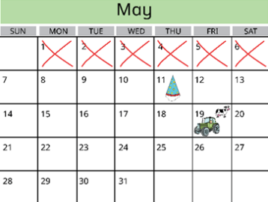
Daily routines
Talk about key events that are happening during the day, week and month.
Count down how many days/sleeps until a key event, such as a birthday.
Notice and talk about the changes that occur during the different seasons.
While getting dressed, talk about the order in which we put on our clothes.

Slide 29

Bedtime routines
Count the steps as children go upstairs.
Measure the bubble bath into the water – how many spoons/squeezes do we need?
Find matching pyjamas – choose the correct top and bottoms to make a set.
Talk through the order of brushing our teeth – wet toothbrush, add toothpaste etc.
Time how long it takes to brush our teeth.

Slide 30
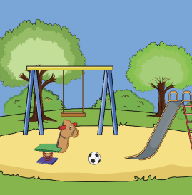
At the park
Look for and talk about different shapes and patterns in the natural environment.
Subitise or count the flowers and plants children can see.
Count the times you go down the slide or turn on the roundabout.
Who is swinging the highest on the swing?

Slide 31
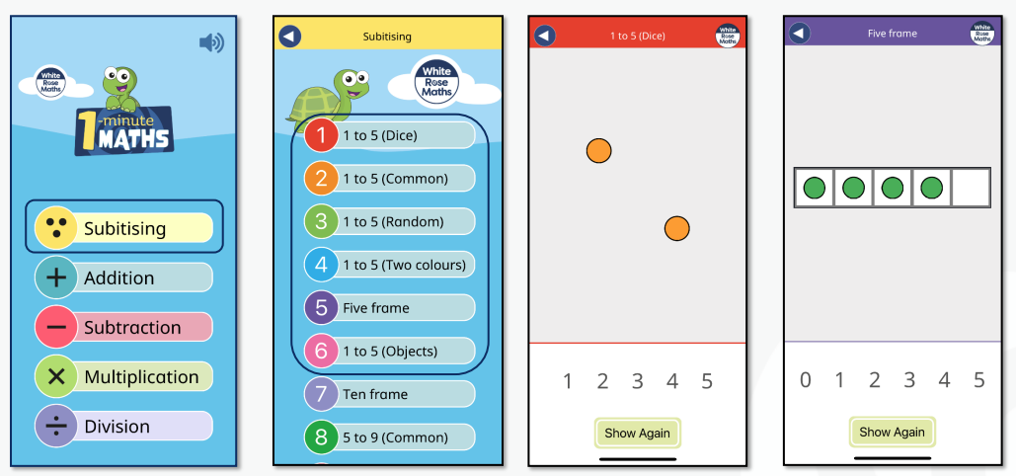
White Rose 1 minute maths
Subitising can be easily practised using the White Rose 1 minute app.

Slide 32


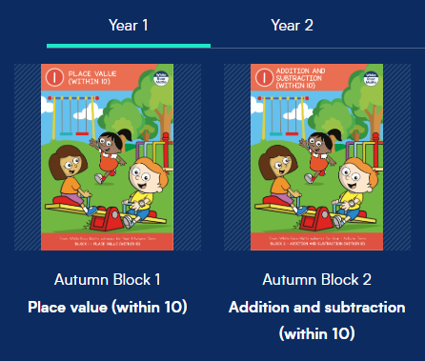
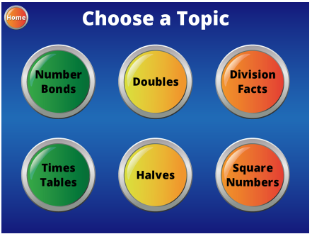

How to help at home
Free parent workbooks
Hit the Button
White Rose Parent Video Guides
EYFS
Count numbers reliably
(using objects, images, sounds)
Create representations for numbers
Place numbers 1-10 in order
Recognise numerals 1-10
Explore one more and one less
Addition and subtraction of numbers 1-10
Understand the concept of 0
Year 1
Count forwards and backwards
Number bonds to 10 then 20
Count in 2’s, 5’s and 10’s
Add and subtract a single digit
number from a 2-digit number
Tell the time using half past and o’clock
Recall doubles and halves

Slide 33


Thank you for coming!
Any questions?

